Slide 1
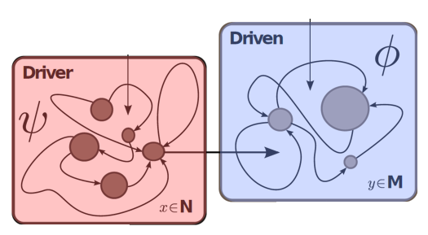
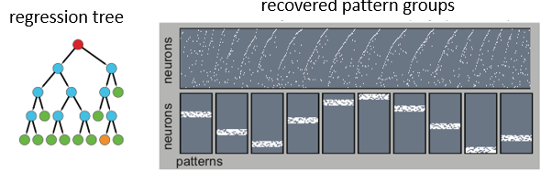
Your Choice
Johannes Schumacher
Schumacher,,Jäckel, Fries, Wunderle, Pipa, ‘A statistical framework to infer delay and direction of information flow from measurements of complex systems’, neural computation,2015
Johannes Schumacher
Haslinger, et al . (2013). Encoding Through Patterns: Regression Tree–Based Neuronal Population Models. Neural computation, 25(8), 1953-1993.
Haslinger et al. (2013). Missing mass approximations for the partition function of stimulus driven Ising models. Frontiers in computational neuroscience, 7.

Slide 2
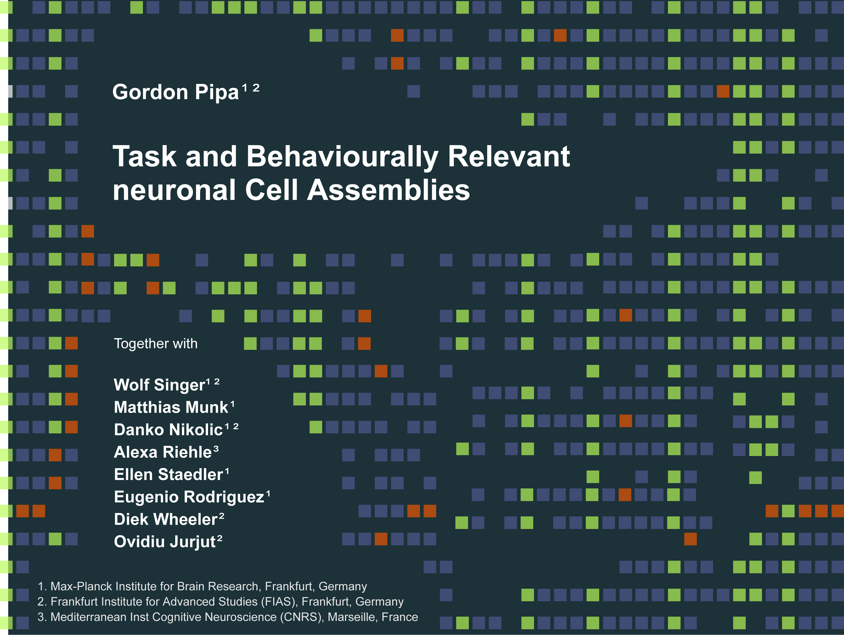
Gordon Pipa
Institute of Cognitive Science
Dept. Neuroinformatics
University of Osnabrück
Inferring functional interactions from neuronal data
Johannes Schumacher¹
Frank Jäckel¹
Pascal Fries²
Thomas Wunderle²
¹ Institute of Cognitive Science - University of Osnabrück
² Ernst Strüngmann Institute (ESI) , Frankfurt, Germany
Notes:
Hallo and thank you for the introduction.
I will present a non-parametric significance test for estimating the statistical significance of Joint-Spike events.

Slide 3
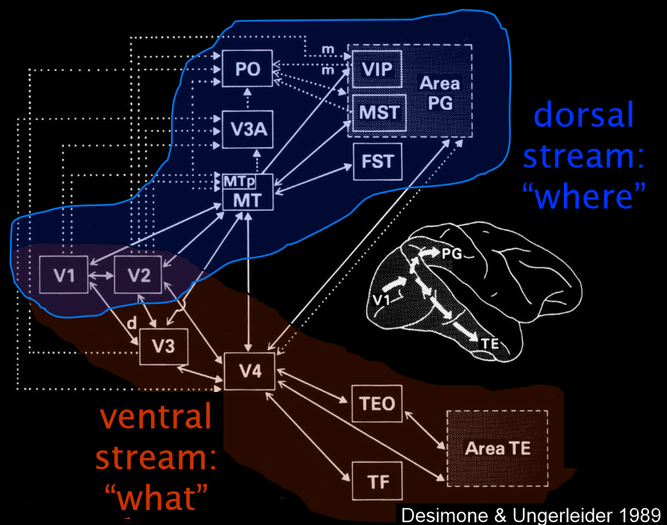
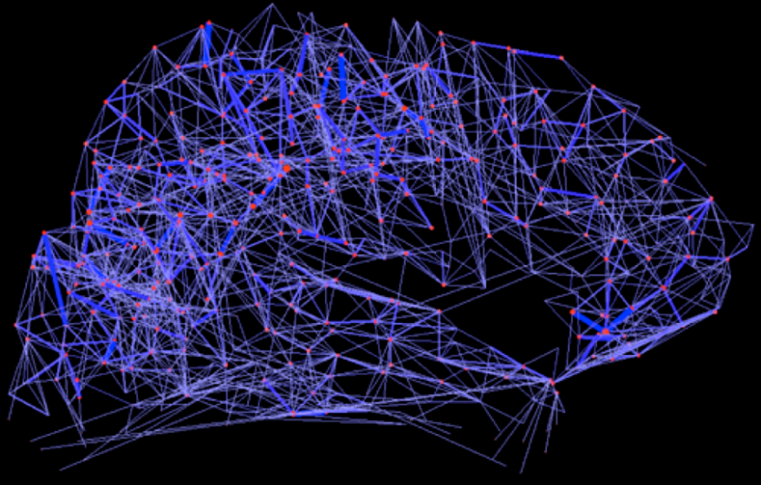
The Brain: An ordered hierarchical system
Hagmann et al. (2008), ’Mapping the structural core of human cerebral cortex’ PLoS Biol 6(7): e159
A dynamical system that is composed of coupled modules
Notes:
I will use the image first to highlight the enormous performance of our visual system and second to illustrate the major mechanism which has to been explain concerning the question
‘ who do the visual system compute the information and to infer 5 horses.’
The First time if have see this picture it toke my a couple of seconds two identify more than 3 horses.
Out of this mechanistic point of view the individual contours and segments described by various contrast relations has to been binned and labeled to identify the relationships that groups of the are belonging to different objects.

Slide 4
Methods to detect causal Drive
Granger type
x_{t,t:τ}
x_{t+1}
L(x_{t+1}|x_{t,t:τ} , y_{t,t:τ})
L(x_{t+1}|x_{t,t:τ})
y_{t,t:τ}
x_{t,t:τ}
L(y_{t+1}|x_{t,t:τ} , y_{t,t:τ})
L(y_{t+1}| y_{t,t:τ})
y_{t,t:τ}
L(x_{t+1}|x_{t,t:τ} , y_{t,t:τ})
L(y_{t+1}|x_{t,t:τ} , y_{t,t:τ})
>
Y → X
L(x_{t+1}|x_{t,t:τ})
L(y_{t+1}| y_{t,t:τ})

Slide 5
Methods to detect causal Drive
Many faces of Granger Causality:
Spectral, auto-regressive, multivariate, state space, nonlinear, kernel-based, Transfer-Entropy, etc.
Basically, G-Causality is a comparison of auto-prediction with a cross-prediction
Granger, C. W. J. 1969 Investigating causal relations by econometric models and cross-spectral methods. Econometrica 37, 424-438.
Granger, C. W. J. 1980 Testing for causality: A personal viewpoint. Journal of Economic Dynamics and Control 2, 329-352.
Schreiber, T. 2000 Measuring information transfer. Phys Rev Lett 85, 461-4.
Vicente, Wibral, Lindner, Pipa, ‘Transfer entropy—a model-free measure of effective connectivity for the neurosciences’, Journal of computational neuroscience 30 (1), 45-67
……….

Slide 6
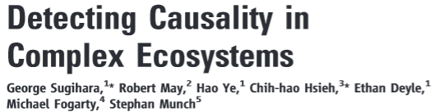
Methods to detect causal Drive
Using a dynamical system perspective
X
Y

Slide 7
Methods to detect causal Drive
Using a dynamical system perspective
X
X
Y
Y becomes a mix of X and Y

Slide 8
Methods to detect causal Drive
Using a dynamical system perspective
X
X
Y
Y becomes a mix of X and Y

Slide 9
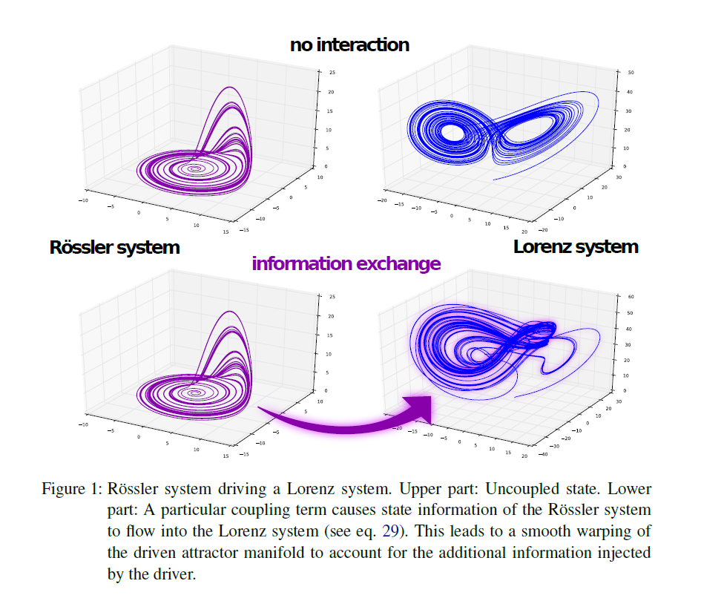
Driven System:
System with m>n dimensional
Driver System:
autonomous System n dimen-sional
Schumacher, J., Wunderle, T., Fries, P., Jäkel, F., & Pipa, G. (2015). A Statistical Framework to Infer Delay and Direction of Information Flow from Measurements of Complex Systems. Neural computation.

Slide 10
Methods to detect causal Drive
Using a dynamical system perspective
X
X
Y
Y becomes a mix of X and Y
Reconstruction of past
X
Y
X
X
X
Y

Slide 11
Network topology: Common drive
Common driving with
unidirectional connections
1
2
3
Coupling Matrix
3→1
1→1
2→1
1→2
2→2
3→2
Color code:
coupled
1→3
2→3
3→3
uncoupled
Sugihara, G., May, R., Ye, H., Hsieh, C. H., Deyle, E., Fogarty, M., & Munch, S. (2012). Detecting causality in complex ecosystems. science, 338(6106), 496-500.
uncoupled
11

Slide 12
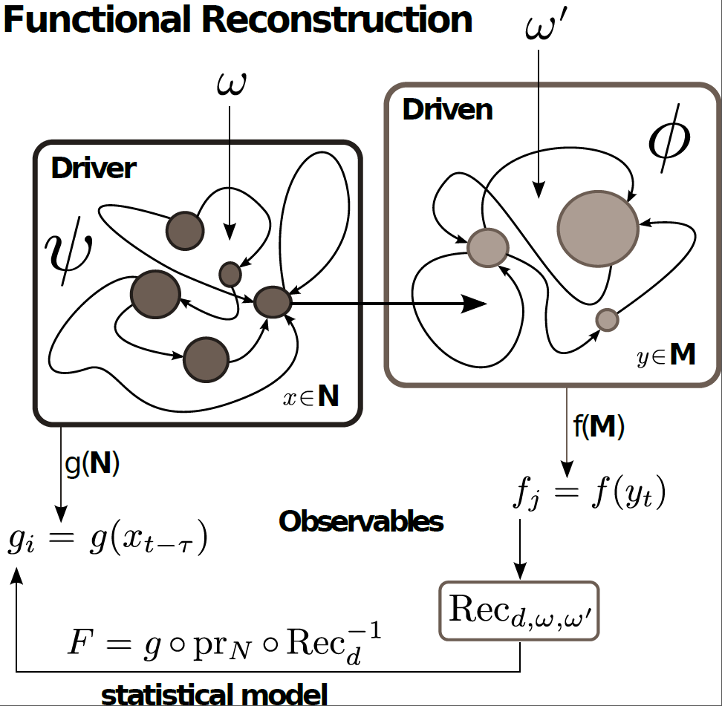
Causality in a Dynamical System
Driven System:
System m>n dimensional
Driver System:
autonomous System n dimen-sional
Schumacher,,Jäckel, Fries, Wunderle, Pipa, ‘A statistical framework to infer delay and direction of information flow from measurements of complex systems’, neural computation,2015
Notes:
I will use the image first to highlight the enormous performance of our visual system and second to illustrate the major mechanism which has to been explain concerning the question
‘ who do the visual system compute the information and to infer 5 horses.’
The First time if have see this picture it toke my a couple of seconds two identify more than 3 horses.
Out of this mechanistic point of view the individual contours and segments described by various contrast relations has to been binned and labeled to identify the relationships that groups of the are belonging to different objects.

Slide 13
Formalizing the problem
Driven System:
System with m>n dimensional
Driver System:
autonomous System n dimen-sional
Stochastic or partly observed drive (high-dimensional non-reconstructible input)
Schumacher,,Jäckel, Fries, Wunderle, Pipa, ‘A statistical framework to infer delay and direction of information flow from measurements of complex systems’, neural computation,2015
Notes:
I will use the image first to highlight the enormous performance of our visual system and second to illustrate the major mechanism which has to been explain concerning the question
‘ who do the visual system compute the information and to infer 5 horses.’
The First time if have see this picture it toke my a couple of seconds two identify more than 3 horses.
Out of this mechanistic point of view the individual contours and segments described by various contrast relations has to been binned and labeled to identify the relationships that groups of the are belonging to different objects.

Slide 14
Formalizing the problem
Driven System:
System with m>n dimensional
Driver System:
autonomous System n dimen-sional
Stochastic or partly observed drive (high-dimensional non-reconstructible input)
Observable:
A set of scalar observables
(e.g. LFP channels)
Schumacher,,Jäckel, Fries, Wunderle, Pipa, ‘A statistical framework to infer delay and direction of information flow from measurements of complex systems’, neural computation,2015
Notes:
I will use the image first to highlight the enormous performance of our visual system and second to illustrate the major mechanism which has to been explain concerning the question
‘ who do the visual system compute the information and to infer 5 horses.’
The First time if have see this picture it toke my a couple of seconds two identify more than 3 horses.
Out of this mechanistic point of view the individual contours and segments described by various contrast relations has to been binned and labeled to identify the relationships that groups of the are belonging to different objects.

Slide 15
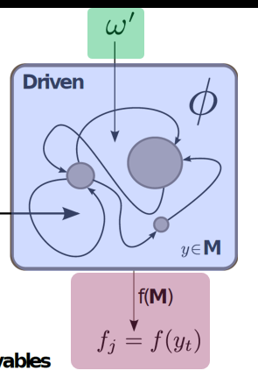
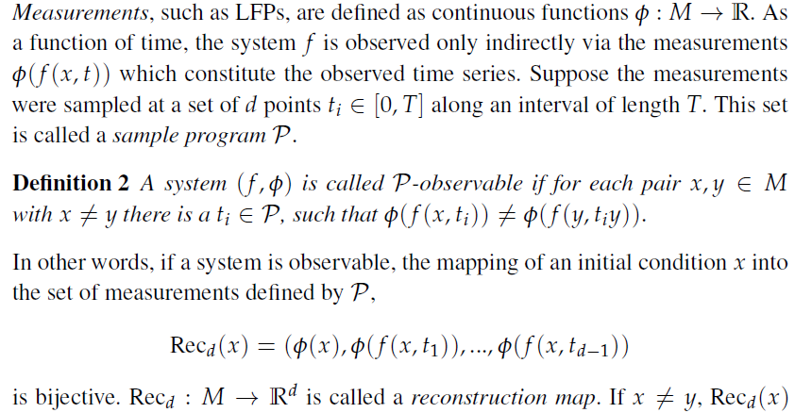
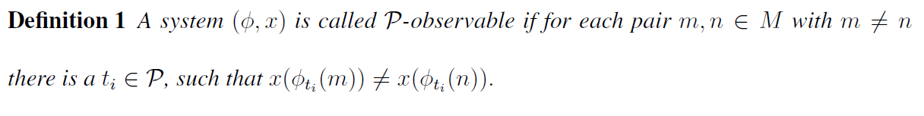
P-Observable:
That means we can go back and forth between Rec_{d} and initial condition x,
or we can reconstruct system dynamics from observation
Aeyels D (1981) Generic observability of differentiable systems. SIAM Journal on Control and
Optimization 19: 595{603}.
Takens F (1981) Dynamical systems and turbulence, warwick 1980: Detecting strange attractors in turbulence. In: Lecture Notes in Mathematics, Springer, volume 898/1981. pp. 366{381}
Takens F (2002) The reconstruction theorem for endomorphisms. Bulletin of the Brazilian Mathematical
Society 33: 231{262.

Slide 16
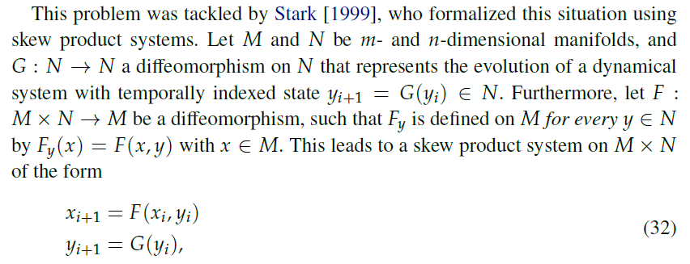
Causality in a Dynamical System
Forced Takens Theorem by Stark:
Stark J (1999) Delay embedding's for forced systems. i.e deterministic forcing. Journal of Nonlinear
Science 9: 255{332.
That means we can can reconstruct the driver x from the driven system y
Notes:
I will use the image first to highlight the enormous performance of our visual system and second to illustrate the major mechanism which has to been explain concerning the question
‘ who do the visual system compute the information and to infer 5 horses.’
The First time if have see this picture it toke my a couple of seconds two identify more than 3 horses.
Out of this mechanistic point of view the individual contours and segments described by various contrast relations has to been binned and labeled to identify the relationships that groups of the are belonging to different objects.

Slide 17
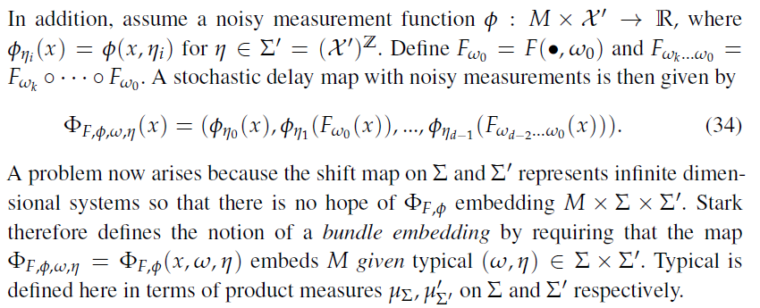
Reconstruction in the presence of noise
Bundel embedding for noisy measurements:
(Stark J, Broomhead DS, Davies M, Huke J (2003) Delay embeddings for forced systems. i.e. stochastic forcing. Journal of Nonlinear Science 13: 519{577.)
That means we can define an embedding for noisy measurements of the driven systems, and reconstruct the driver
Notes:
I will use the image first to highlight the enormous performance of our visual system and second to illustrate the major mechanism which has to been explain concerning the question
‘ who do the visual system compute the information and to infer 5 horses.’
The First time if have see this picture it toke my a couple of seconds two identify more than 3 horses.
Out of this mechanistic point of view the individual contours and segments described by various contrast relations has to been binned and labeled to identify the relationships that groups of the are belonging to different objects.

Slide 18
Causality in a Dynamical System
P-Observable:
Driven system
To reconstruct the driver we reconstruct F, that is the projected skew product on the manifold N and used the measurement function g
Notes:
I will use the image first to highlight the enormous performance of our visual system and second to illustrate the major mechanism which has to been explain concerning the question
‘ who do the visual system compute the information and to infer 5 horses.’
The First time if have see this picture it toke my a couple of seconds two identify more than 3 horses.
Out of this mechanistic point of view the individual contours and segments described by various contrast relations has to been binned and labeled to identify the relationships that groups of the are belonging to different objects.

Slide 19


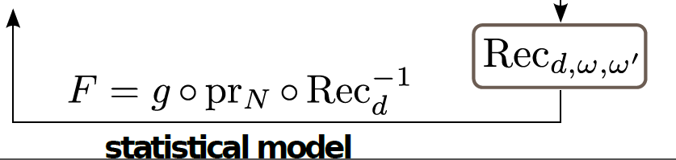
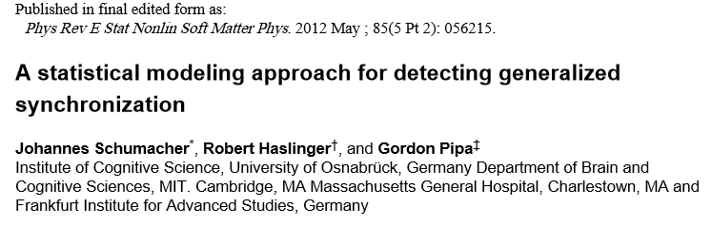
Causality in a Dynamical System
Driver
Driven
Notes:
I will use the image first to highlight the enormous performance of our visual system and second to illustrate the major mechanism which has to been explain concerning the question
‘ who do the visual system compute the information and to infer 5 horses.’
The First time if have see this picture it toke my a couple of seconds two identify more than 3 horses.
Out of this mechanistic point of view the individual contours and segments described by various contrast relations has to been binned and labeled to identify the relationships that groups of the are belonging to different objects.

Slide 20
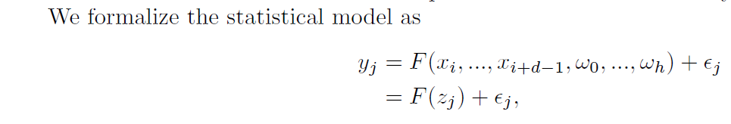
Causality in a Dynamical System
Driver
Driven
Notes:
I will use the image first to highlight the enormous performance of our visual system and second to illustrate the major mechanism which has to been explain concerning the question
‘ who do the visual system compute the information and to infer 5 horses.’
The First time if have see this picture it toke my a couple of seconds two identify more than 3 horses.
Out of this mechanistic point of view the individual contours and segments described by various contrast relations has to been binned and labeled to identify the relationships that groups of the are belonging to different objects.

Slide 21
Causality in a Dynamical System
Driver
Driven
Moreover F is parameterized by a Volterra Kernel, leading to a Gaussian Process Framework
Notes:
I will use the image first to highlight the enormous performance of our visual system and second to illustrate the major mechanism which has to been explain concerning the question
‘ who do the visual system compute the information and to infer 5 horses.’
The First time if have see this picture it toke my a couple of seconds two identify more than 3 horses.
Out of this mechanistic point of view the individual contours and segments described by various contrast relations has to been binned and labeled to identify the relationships that groups of the are belonging to different objects.

Slide 22
Statistical Model
Use of finite Order Volterra models with L1 (~ Identification of best embedding )
Alternatively we use infinite Order Volterra Kernel in Hilbert space (no explicit generative model anymore)
Model of posterior of predicted driver – Predictive distribution
Extremely few data points are needed compared to information theoretic approaches
Notes:
I will use the image first to highlight the enormous performance of our visual system and second to illustrate the major mechanism which has to been explain concerning the question
‘ who do the visual system compute the information and to infer 5 horses.’
The First time if have see this picture it toke my a couple of seconds two identify more than 3 horses.
Out of this mechanistic point of view the individual contours and segments described by various contrast relations has to been binned and labeled to identify the relationships that groups of the are belonging to different objects.

Slide 23
Summary I
If system A drives B the information of A and B is in B
Than, one can reconstruct A from B using an embedding, but not B from A
This works if both system are represented by noisy measure, this includes both real noise and incomplete observations
To reconstruct A we model F based on a Volterra Kernel and Gaussian process assumption

Slide 24
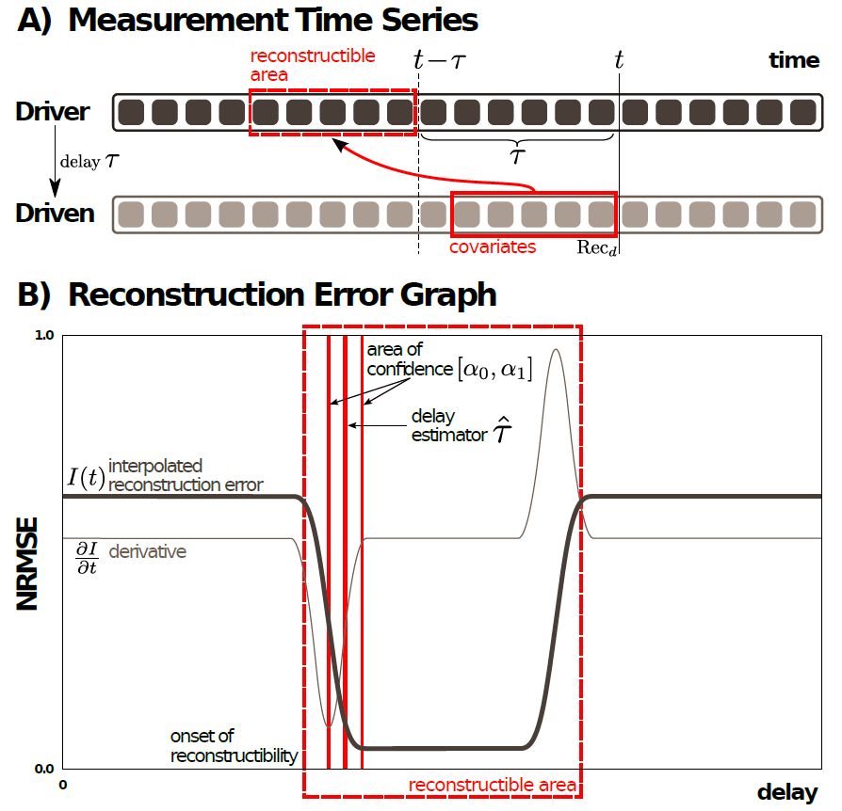

Slide 25
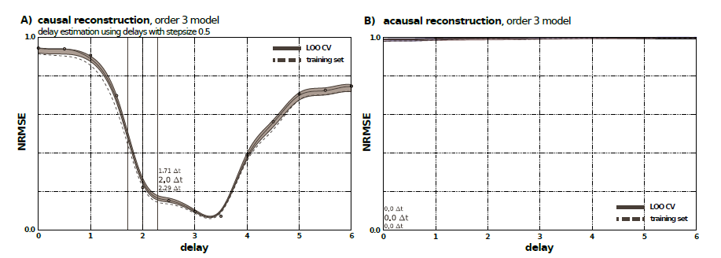
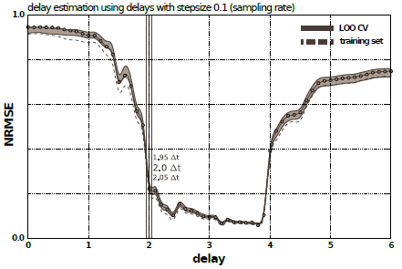
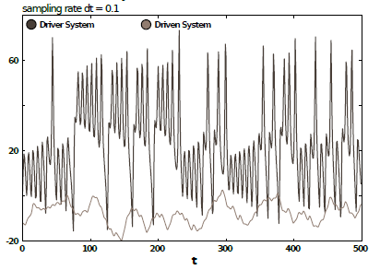
Delay-coupled Lorenz-Rössler System

Slide 26
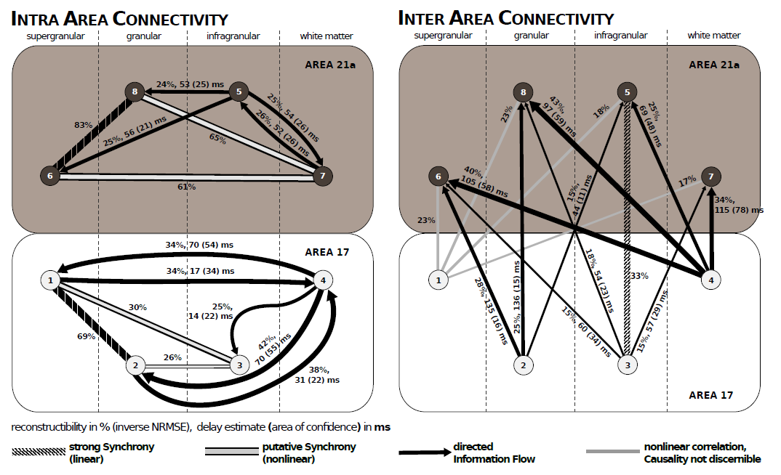
Grating, cat, A18 and A21, 50 trials, rec. dimension d = 20, Rec_{d} spans an area
of 300ms

Slide 27
Only one model for every direction. Compared to Granger where we do not have to compare the auto with cross model which prevents false detection because of bad auto models.
Works for weak and intermediate coupling strength
Formulates a non-linear statistical model, therefore enables the use of state of the art machine learning
Uses a Bayesian model which enables the use of predictive distributions therefore allowing for a simple and fully intuitive model comparison

Slide 28
Gordon Pipa
Institute of Cognitive Science
Dept. Neuroinformatics
University of Osnabrück
Inferring functional interactions from neuronal data
Robert Haslinger^{3,4}
Laura Lewis³
Danko Nikolić²
Ziv Williams⁴
Emery Brown^{3,4}
¹ Institute of Cognitive Science - University of Osnabrück
³ Brain and Cognitive Sciences, MIT, Cambridge, US
⁴ Massachusetts General Hospital , Boston, US
Notes:
Hallo and thank you for the introduction.
I will present a non-parametric significance test for estimating the statistical significance of Joint-Spike events.

Slide 29
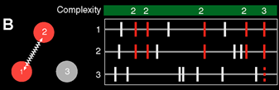
Assembly coding and temporal coordination
Hypothesis: Assembly coding and temporal coordination
Temporally coordinated activity of groups of neurons (assemblies) processes and stores information, based on coordination emerging from interactions in the complex neuronal network.
Hebb, ‘Organisation of behaviour. A neurophysiological theory’ , New York: John Wiley & Sons, 1949
Uhlhaas, Pipa, Lima, Melloni, Neuenschwander, Nikolić, Singer, ‘Neural synchrony in cortical networks: history, concept and current status’, Frontiers in integrative Neuroscience, 2009
Vicente, Mirasso, Fischer, Pipa, ‘Dynamical relaying can yield zero time lag neuronal synchrony despite long conduction delays, PNAS 2008
Pipa , Wheeler , Singer , Nikolić, ‘NeuroXidence: reliable and efficient analysis of an excess or deficiency of joint-spike events’, J. comp. neuroscience 2008
Pipa, Munk, ‘Higher order spike synchrony in prefrontal cortex during visual memory ‘, Frontiers in Comp. neuros-, 2011

Slide 30
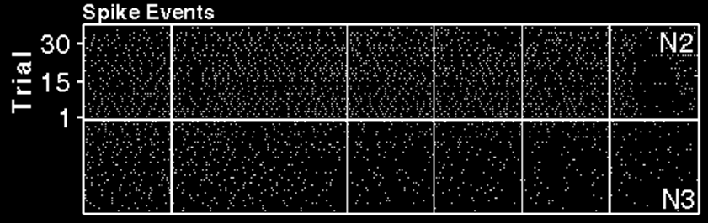
Data: Task: NeuroXidence:
2 simultaneously recorded cells, 38 trials Delayed pointing Number of surrogates: S = 20
Monkey primary motor cortex (awake) Riehle, et al. 97 Science Window length: l=0.2 s
PS ES1 ES2 ES3 RS
G Pipa, A Riehle, S Grün, ‘Validation of task-related excess of spike coincidences based on NeuroXidence’, Neurocomputing 70 (10), 2064-2068

Slide 31
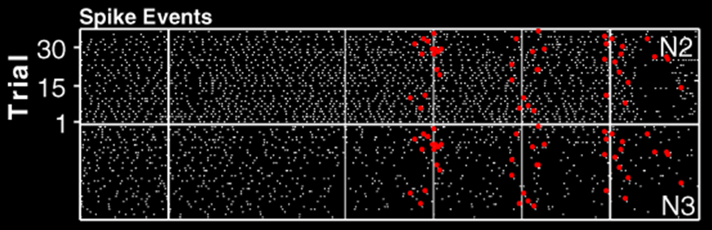
Synchrony should vary in time to be computationally relevant
Data: Task: NeuroXidence:
2 simultaneously recorded cells, 38 trials Delayed pointing Number of surrogates: S = 20
Monkey primary motor cortex (awake) Riehle, et al. 97 Science Window length: l=0.2 s
PS ES1 ES2 ES3 RS
G Pipa, A Riehle, S Grün, ‘Validation of task-related excess of spike coincidences based on NeuroXidence’, Neurocomputing 70 (10), 2064-2068

Slide 32
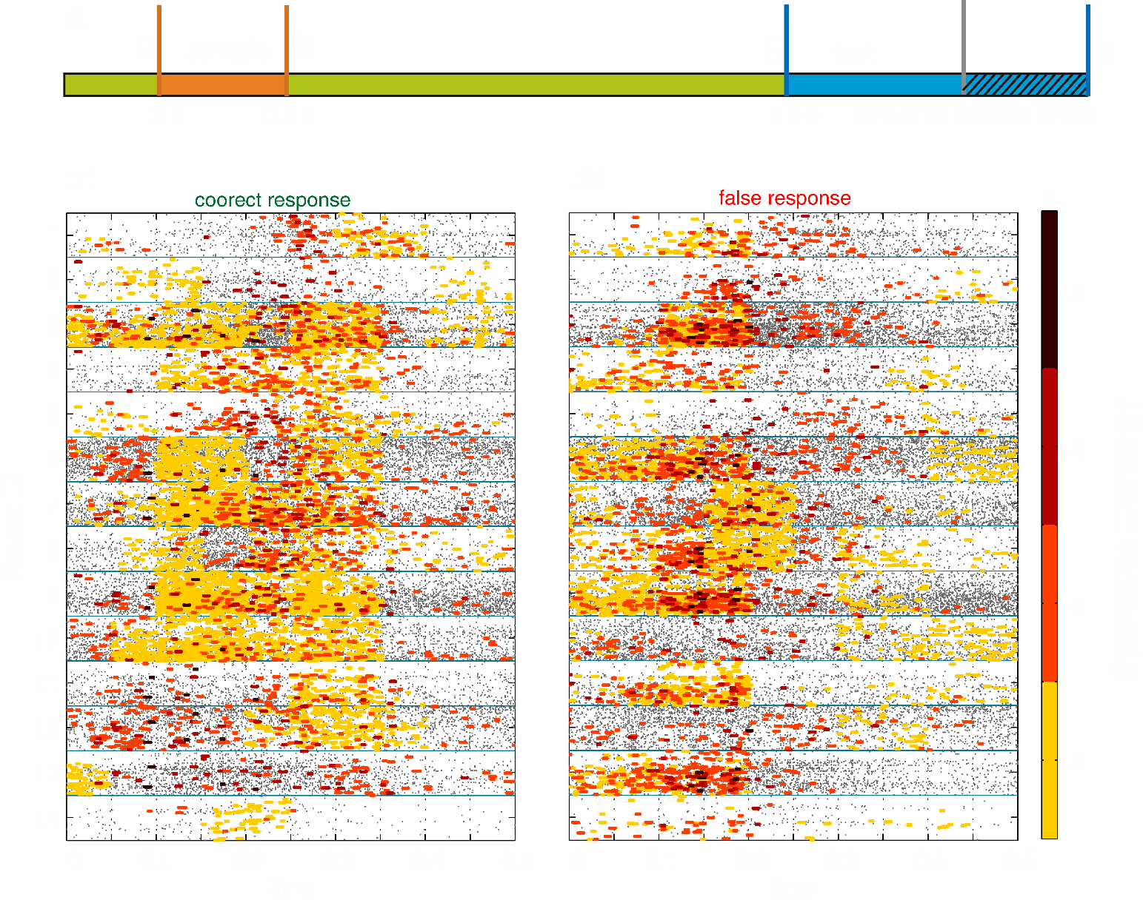
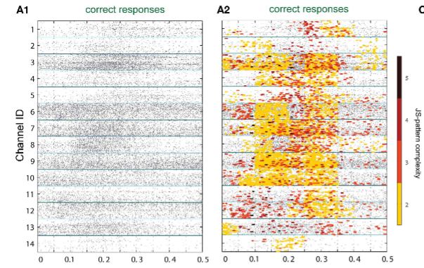
Performance related cell-assembly formation
Dataset:
Monkey prefrontal cortex
Short term memory, delayed matching to sample paradigm
27 cells simultaneously recorded cells
Number of different Patterns :
18150
Pipa, G., & Munk, M. H. (2011). Higher order spike synchrony in prefrontal cortex during visual memory. Frontiers in computational neuroscience, 5.

Slide 33
Challenges to overcome
We are interested in how patterns encode that is how their probabilities vary with a multidimensional external covariate (a stimulus).
So the grouping should reflect the encoding ... but we don’t know how the groups.
We have no training set telling us the probabilities, we have multinomial observations from which we have to infer the probabilities.
We also don’t know the functional form these probabilities should take, that is, the mapping from stimulus to pattern.
We will use a divisive clustering algorithm (hopefully ending up with the right clusters)
This clustering will be constructed to maximize the data likelihood, and hopefully generalize to test data.
We will use an iterative expectation maximization type splitting algorithm.
Haslinger, R., Pipa, G., Lewis, L. D., Nikolić, D., Williams, Z., & Brown, E. (2013). Encoding Through Patterns: Regression Tree–Based Neuronal Population Models. Neural computation, 25(8), 1953-1993.
Haslinger, R., Ba, D., Galuske, R., Williams, Z., & Pipa, G. (2013). Missing mass approximations for the partition function of stimulus driven Ising models. Frontiers in computational neuroscience, 7.

Slide 34
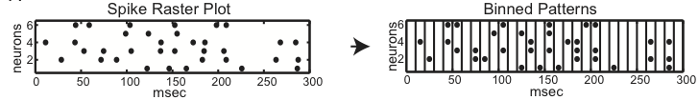
Temporally Bin
Patterns
1
M
Identify Patterns
Cluster Patterns
(But how ?)
M unique patterns
neurons
Split into C clusters
Encoding with Patterns:
Patterns with the same temporal profile of p(t) belong to the same assemblies
Haslinger, R., Pipa, G., Lewis, L. D., Nikolić, D., Williams, Z., & Brown, E. (2013). Encoding Through Patterns: Regression Tree–Based Neuronal Population Models. Neural computation, 25(8), 1953-1993.
Haslinger, R., Ba, D., Galuske, R., Williams, Z., & Pipa, G. (2013). Missing mass approximations for the partition function of stimulus driven Ising models. Frontiers in computational neuroscience, 7.

Slide 35

Discrete Time Patterns
Temporally Bin
Patterns
M unique patterns
Multiplicative Model
Pm
mean pattern
probability
stimulus
modulation
stimulus
Lots of methods for estimating this
Use tree to estimate this.

Slide 36
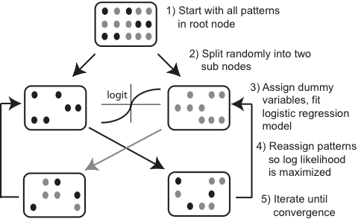

Expectation Maximization Splitting Algorithm
logistic regression model
This algorithm maximizes the data likelihood. It does not depend on patterns “looking similar” or some other prior, although priors can be reintroduced

Slide 37
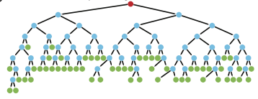
Generalizing to Novel Patterns
Test data may (will) have pattern not seen in training data
Assign new patterns to leaf to containing patterns which which it is “closest” (has smallest Hamming distance)

Slide 38
Generalizing to Novel Patterns
Test data may (will) have pattern not seen in training data
Good-Turing Estimator of Missing Mass
Problem:
Assigns zero probability to all patterns not in training data

Slide 39
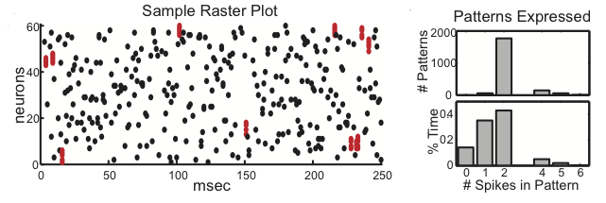
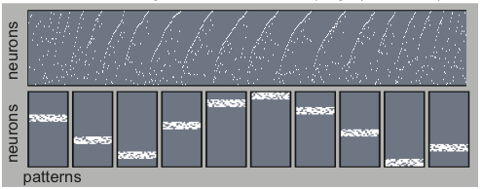
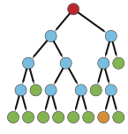
2031 unique patterns, many of which are very rare
recovered pattern groups
regression tree
Independent neuron group
The 10 correct pattern groupings are recovered
Pattern Generation :
multinomial logit model (One Pattern at a time)
In total 60 neurons, for 100 sec
Independent firing with 40 Hz for 92% of time
10 Groups that fire each at 0.8% of time.
Each group composes 22 patterns

Slide 40

2031 unique patterns, many of which are very rare
recovered pattern groups
regression tree
Independent neuron group
The 10 correct pattern groupings are recovered
The covariation of the patterns probabilities with the stimulus is recovered

Slide 41
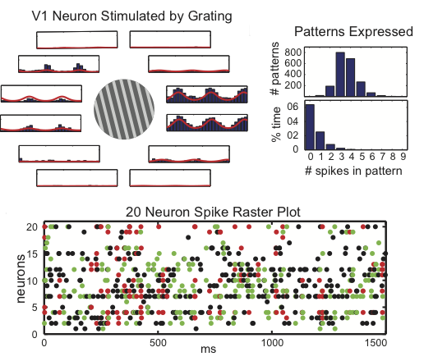
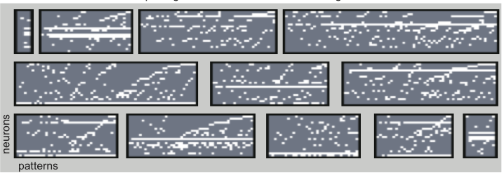
Cat V1 with grating stimulus
0.8 Hz Grating presented with repeated trials in 12 directions
regression tree
20 neuron population:
2600 unique patterns
parameterize stimulus as function of grating direction, and of time since stimulus onset
patterns comprising 12 leaves
V1 cat data from Danko Nikolic’

Slide 42
Compare regression tree to collection of independent neuron models.

Slide 43
Compare regression tree to collection of independent neuron models.
Good Turing Estimate
Ising model

Slide 44
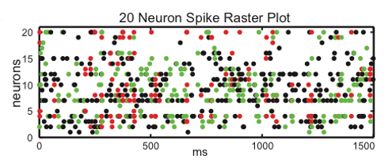
One spike pattern
Two spike pattern
Three spike pattern

Slide 45
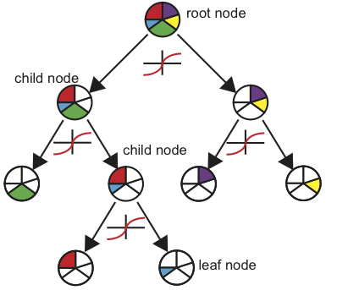
Discussion and conclusion
Pattern encoding/decoding
Grouping is based on just the temporal profile of pattern occurrence
Can work with very large numbers of neurons
Find the number of clusters automatically
More Data → More detailed models
Generative model for encoding with patterns and independent spiking
Better than Ising Model
1
M
neurons
Haslinger, R., Pipa, G., Lewis, L. D., Nikolić, D., Williams, Z., & Brown, E. (2013). Encoding Through Patterns: Regression Tree–Based Neuronal Population Models. Neural computation, 25(8), 1953-1993.
Haslinger, R., Ba, D., Galuske, R., Williams, Z., & Pipa, G. (2013). Missing mass approximations for the partition function of stimulus driven Ising models. Frontiers in computational neuroscience, 7.

Slide 46
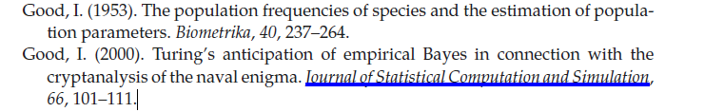

Slide 47
Encoding Based Pattern Clustering
1
M
Assume some patterns convey similar information about the stimulus
M unique patterns
neurons
Split into C clusters
Use Regression Tree to Divisively Cluster Patterns
Each split defined by a logistic regression model dependent on stimulus
Leaves of tree are the pattern groupings
Tree is an stimulus encoding model for each unique pattern observed

Slide 48
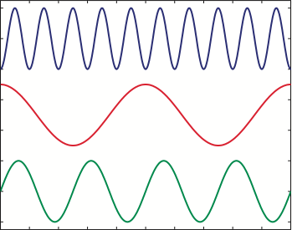
60 Simulated Neurons: 11 Functional Groups
1 independent neuron “group”
(Poisson firing)
Independent Firing
Collective Firing
10 “groups” of 6 neurons, each with 22 unique patterns (4 or more neurons firing)
a group is activated for certain values of a time varying “stimulus”
“Stimulus”
“Stimulus” is 24 dimensional: sine waves of varying frequency and phase offset
3 out of 24
time

Slide 49
Encodings based upon patterns can be compared to encodings based upon independent neurons.
Do model comparison with log likelihood which is additive
Depends on mean probability (over all stimuli) of observing the pattern
Depends on covariation of pattern probability with stimulus

Slide 50
