Slide 1


Biophysical reaction-diffusion model for stage II retinal waves and bifurcations analysis
T. Karvouniari, L. Gil , B. Cessac
Nice, September 2015

Slide 2
Our goal
Idea:
Build a biophysical generic model to study mechanisms generating stage II retinal waves

Slide 3
Our goal
Idea:
Build a biophysical generic model to study mechanisms generating stage II retinal waves
Motivation:
Retinal waves instruct the shaping of the visual system
Understanding the mechanisms that generate them may help to control them
Use retinal waves to re-train the retina re-wire and possibly restore vision partially for certain pathologies

Slide 4
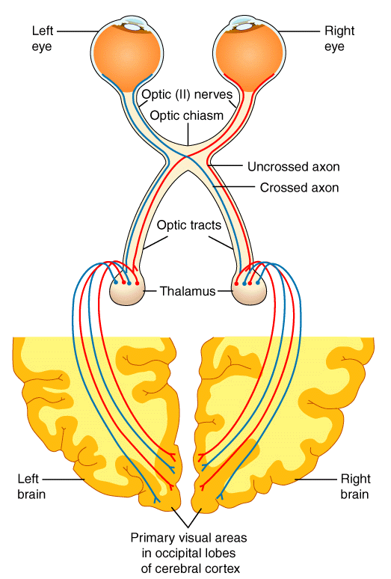
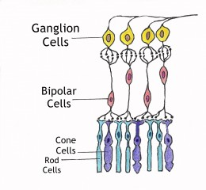
Visual System
Retina
Lateral Geniculate Nucleus
(LGN)
Primary Visual Cortex

Slide 5

Spontaneous Retinal Waves During Development
Spontaneous spatio-temporal ‘’waves’’ during development
Disappear short after birth
Retina
Lateral Geniculate Nucleus
(LGN)
Primary Visual Cortex
Spatio-Temporal evolution of a retinal wave in mice during development, Maccione et al. 2014

Slide 6
Spontaneous Retinal Waves During Development
Spontaneous spatio-temporal ‘’waves’’ during development
Disappear short after birth
Role of Retinal Waves
Retina circuitry formation
Instruction for retinotopic mapping
Eye specific segregation
Spatio-Temporal evolution of a retinal wave in mice during development, Maccione et al. 2014

Slide 7
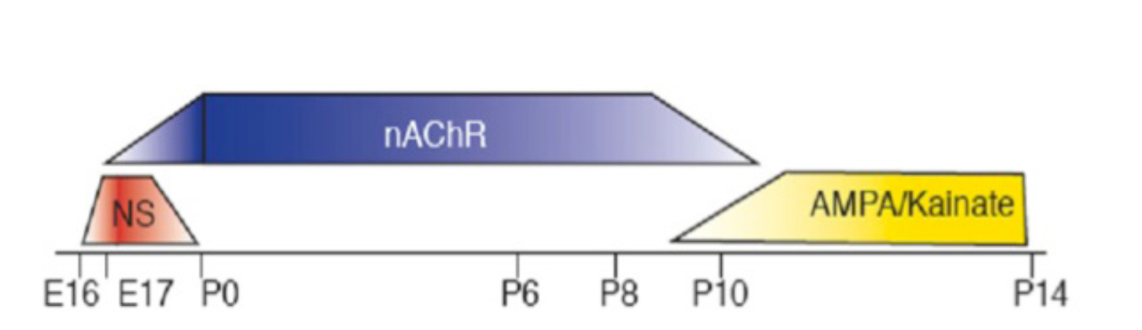
Stages of Retinal Waves During Development
Stage II
Stage III
Stage I

Slide 8
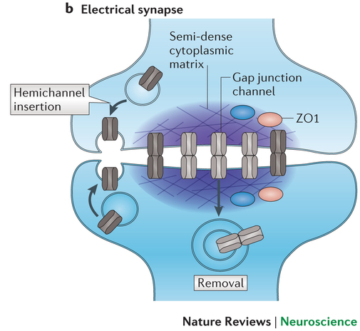
Stages of Retinal Waves During Development
Stage I
Formation of retina
circuitry
Chemical synapses not
formed yet
Gap juction-mediated
Stage I
webvision.med.utah.edu

Slide 9
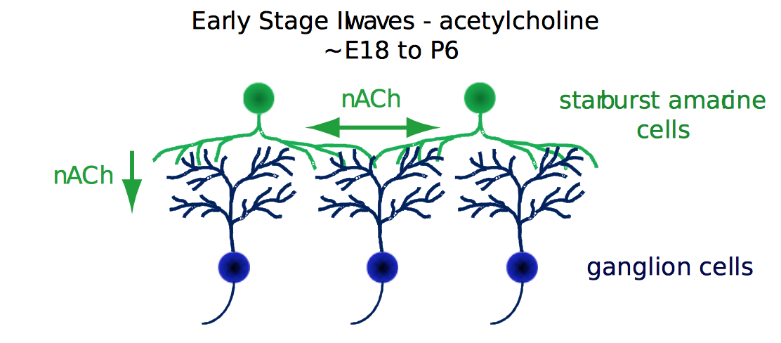
Stages of Retinal Waves During Development
Stage II
Retinotopic mapping
Nicotinic Acetylcholine Receptors (nAChR)
Starbust Amacrine Cells (SACs)
Refractory mechanism
Random ignition and random boundaries
No overlapping
E. Sernagor, M. Hennig,2012
Stage II
webvision.med.utah.edu

Slide 10
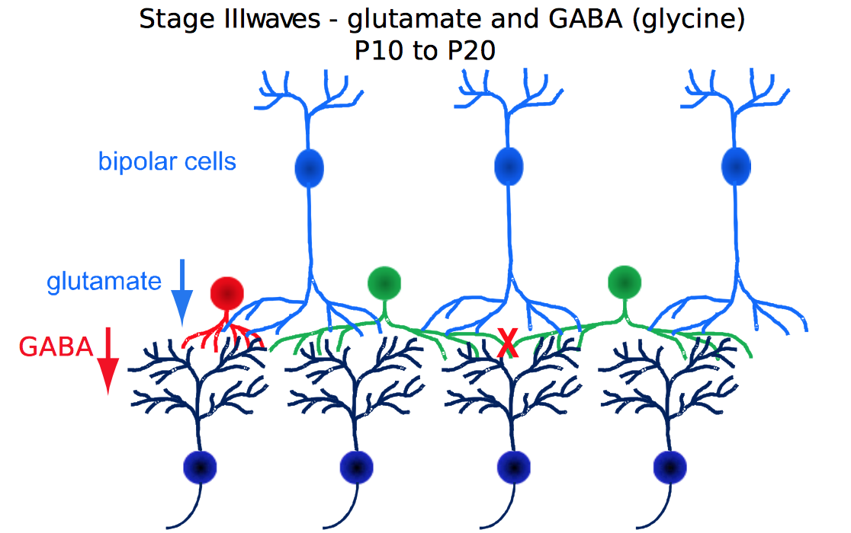
Stages of Retinal Waves During Development
Stage III
Disappear when vision is functional
Glutamate – AMPA receptors
Bipolar cells – IPL
GABA switches polarity
Characteristics depend on species
E. Sernagor, M. Hennig, 2012
webvision.med.utah.edu
Stage III

Slide 11
Retinal waves in the adult retina
Some wave activity can be restored pharmacologically in the adult retina
Data from Vision Institute, 2014
S.Picaud, O. Marre
Analysis with EnaS software, Inria

Slide 12
Retinal waves in adult retina
Some wave activity can be restored pharmacologically
in the adult retina
but

Slide 13
Retinal waves in adult retina
Some wave activity can be restored pharmacologically
in the adult retina
but
It is not yet known which type of « waves » is re-initiated in the adult retina
Re-initiating waves in adult retina could help re-induce plasticity in pathological retina and possibly have a link to therapy
In order to study adult retina wave activity we need to first study developmental waves

Slide 14
How to characterize developmental Retinal Waves?
Biophysical characterization
Pharmacological manipulations allow to differentiate retinal waves in to 3 stages (I,II,III)

Slide 15
How to characterize developmental Retinal Waves?
Biophysical characterization
Pharmacological manipulations allow to differentiate retinal waves in to 3 stages (I,II,III)
Quantitative characterization
Distribution of the waves :
Size
Duration
Power law distributions (maximal variance)
Compute the waves :
Speed
Frequency

Slide 16
How to characterize developmental Retinal Waves?
Mathematical characterization
From the non linear physics perspective a retinal wave is a spatiotemporal activity which:
is generated by the conjunction of local (cell level) nonlinear characteristics and network effects
can have different forms (fronts, spiral, standing waves, spatio-temporal chaos)
is induced by generic mechanisms that can be studied in the context of dynamical systems
can be associated with bifurcations

Slide 17
Open Questions
Which type of « wave » (spatio-temporal activity) is observed? (front, spiral, standing wave etc.)

Slide 18
Open Questions
Which type of « wave » (spatio-temporal activity) is observed? (front, spiral, standing wave etc.)
Which generic effects induce these waves on the dynamical systems aspect? (biophysical mechanisms, network effects, nonlinear dynamics)

Slide 19
Open Questions
Which type of « wave » (spatio-temporal activity) is observed? (front, spiral, standing wave etc.)
Which generic effects induce these waves on the dynamical system aspect? (biophysical mechanisms, network effects, nonlinear dynamics)
What are the effects of local characteristics (neuron properties) versus the network effects?

Slide 20
Open Questions
Which type of « wave » (spatio-temporal activity) is observed? (front, spiral, standing wave etc.)
Which generic effects induce these waves on the dynamical system aspect? (biophysical mechanisms, network effects, nonlinear dynamics)
What are the effects of local characteristics (neuron properties) versus the network effects?
How waves depend on pharmacological manipulation?

Slide 21
Open Questions
Which type of « wave » (spatio-temporal activity) is observed? (front, spiral, standing wave etc.)
Which generic effects induce these waves on the dynamical system aspect? (biophysical mechanisms, network effects, nonlinear dynamics)
What are the effects of local characteristics (neuron properties) versus the network effects?
How waves depend on pharmacological manipulation?
Which type of spatiotemporal correlations do retinal waves generate and what is the effect in the shaping of visual system?

Slide 22
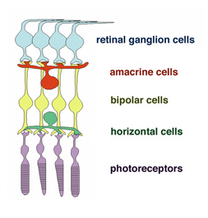
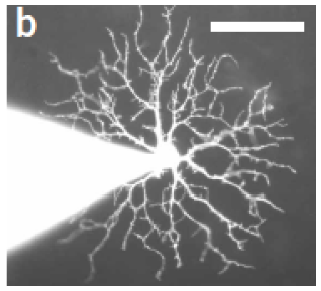
Focus on stage II retinal waves
Stage II retinal waves are well studied experimentally and there is already existing work on their modelling
Starbust Amacrine Cell (SAC)
Stage II
(cholinergic retinal waves)
Zheng et al. 2006
groups.oist.jp/dnu/

Slide 23
Our goal
Idea:
Build a generic model to study the mechanisms generating stage II retinal waves
First step:
Generalization and adaptation of Hennig et al. 2009 and Lansdell et al. 2014 models

Slide 24

A reaction-diffusion neuron model for stage II retinal waves
Morris-Lecar
Morris-Lecar

Slide 25
A reaction-diffusion neuron model for stage II retinal waves
Morris-Lecar
sAHP current
Refractory mechanism
Morris-Lecar

Slide 26
A reaction-diffusion neuron model for stage II retinal waves
Morris-Lecar
Ach current
Network effect
sAHP current
Refractory mechanism
Morris-Lecar

Slide 27
A reaction-diffusion neuron model for stage II retinal waves
Morris-Lecar
Ach current
Network effect
sAHP current
Refractory mechanism
Morris-Lecar
External current
Ignition of waves

Slide 28
sAHP current
Role and effect on retinal waves [Zheng 2006 , Ford 2012]
Alters the refractory period in between waves
Modulates wave frequency
Random boundaries of the waves
Network effect - sAHP dictates the interburst intervals

Slide 29
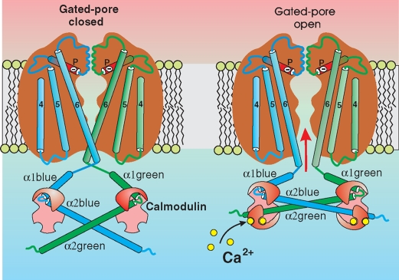
sAHP current
Definition
Slow After Hyperpolarization Current
Calcium-dependent slow potassium current
Mechanism
Model SK-like channels [Abel 2004]
Gating Mechanism: Calmodulin(CaM) binds to four ions
Calcium gated potassium channel
➔
superhimik.livejournal.com/
Closed
Open

Slide 30
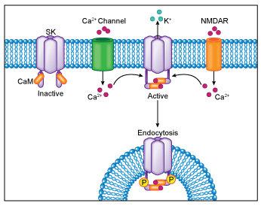
Set of equations for sAHP current
S : Fraction of saturated calmodulin concentration (CaM)
[CaM] : Steady state for saturated calmodulin concentration
➔
Calcium gated potassium channel

Slide 31

Set of equations for sAHP current
S : Fraction of saturated calmodulin concentration (CaM)
[CaM] : Steady state for saturated calmodulin concentration
R : Probability that one terminal of the channel is open
➔
Calcium gated potassium channel

Slide 32
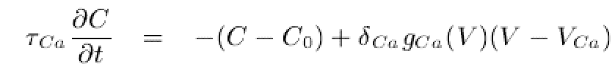
Set of equations for sAHP current
S : Fraction of saturated calmodulin concentration (CaM)
[CaM] : Steady state for saturated calmodulin concentration
R : Probability that one terminal of the channel is open
C : Intracellular Calcium
concentration
➔
Calcium gated potassium channel

Slide 33
sAHP current
Equations for R,S mimic the binding of CaM subunits and their changes of conformation
Four ions bind to calmodulin and open the channel
current depends on gating variable R as follows:
The conductance is proportional to the fourth power of R because four pores are needed to open the channel.
superhimik.livejournal.com/

Slide 34
Parameter issues
The choice of the parameters values can change dramatically the behaviour of the system
Issues with two parameters values , , given in the paper of Hennig et al.
In Hennig et al. model with no units
In Graupner et al. 2003
In Hennig et al. Model with no units
After computation based on physics

Slide 35
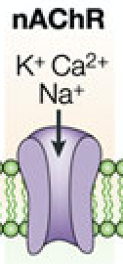
Acetylcholine current
Molecular nicotinic receptors (nAchR)
Two molecules of acetylcholine bind to open a nicotinic channel
The nicotinic conductance depends on the second power of the acetylcholine neurotransmitter concentration A

Slide 36
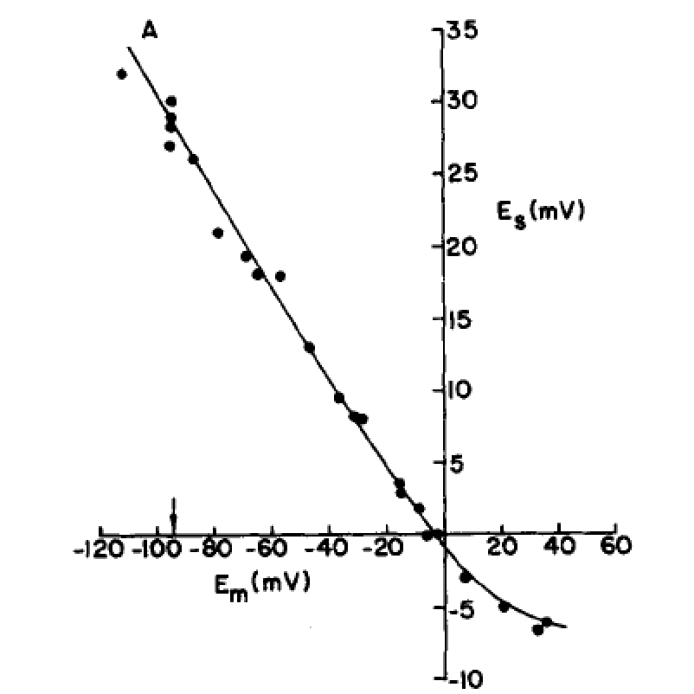
Acetylcholine current
nAchR channel is permeable to three cations
Reversal potential [Lassignal 1977]
≠
Which was chosen by Lansdell et al.
Reversal potential of Ach,Lassignal,1977

Slide 37
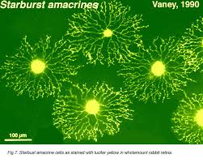
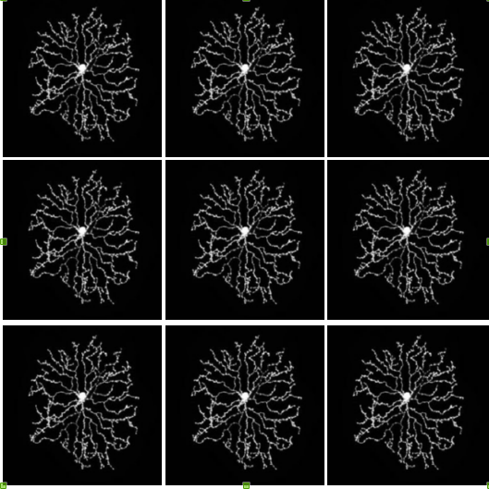
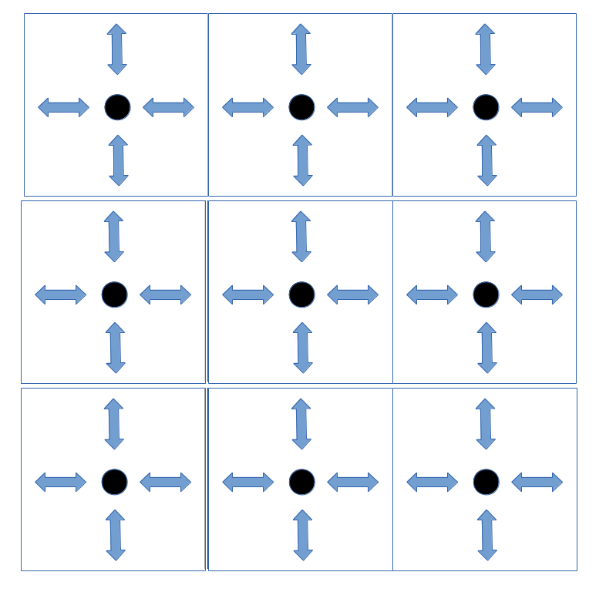
SACs & Diffusion
Model synaptic interactions
SACs realistic connections
SACs on a lattice
SACs become points on a lattice

Slide 38

Acetylcholine current
Diffusion of acetylcholine neurotransmitter in nicotinic receptors [Lansdell 2014]
Diffusion is the only spatial coupling in the
model
Effective diffusion process – averaging
Cholinergic waves modulated by Ach extracellular concentration A

Slide 39
External current
Mimics the random opening of Ca channels generating an intrinsic extra current in SACs activity [Zheng, 2006]
Add a voltage dependent external current to play the role of the trigger of a burst [Hennig, 2009]

Slide 40
Full set of equations

Slide 41
Fixing the parameters of the model
We have a nonlinear system with high sensitivity in the change of some parameters
Some values of parameters are fixed by biophysics
E.g. Reversal potentials
Then vary some free parameters to study the effect on the dynamics
Mainly varying the conductance of a channel due to pharmacological manipulations

Slide 42
Reducing the equations towards Lansdell et al. model

Slide 43
Reducing the equations towards Lansdell et al. model

Slide 44
Reducing the equations towards Lansdell et al. model

Slide 45
Reducing the equations towards Lansdell et al. model

Slide 46
Reducing the equations towards Lansdell et al. model

Slide 47
Lansdell et al. model

Slide 48
Exploring the range of parameters in Lansdell et al. Model
Calcium and potassium conductance
Start from Lansdell et al. model which is a specific case of ours with their chosen values of parameters
Varying the amplitude of the calcium conductance
Then keep the model but change the value of of acetylcholine and test the effect on dynamics

Slide 49
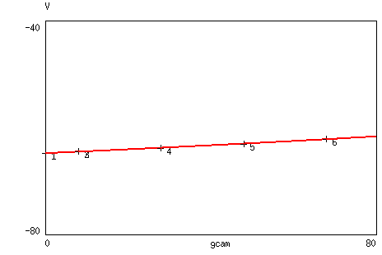
Bifurcation analysis of Lansdell et al. Model
Calcium conductance
We performed the bifurcation analysis for the given set of parameters in the paper of Lansdell varying the parameter

Slide 50
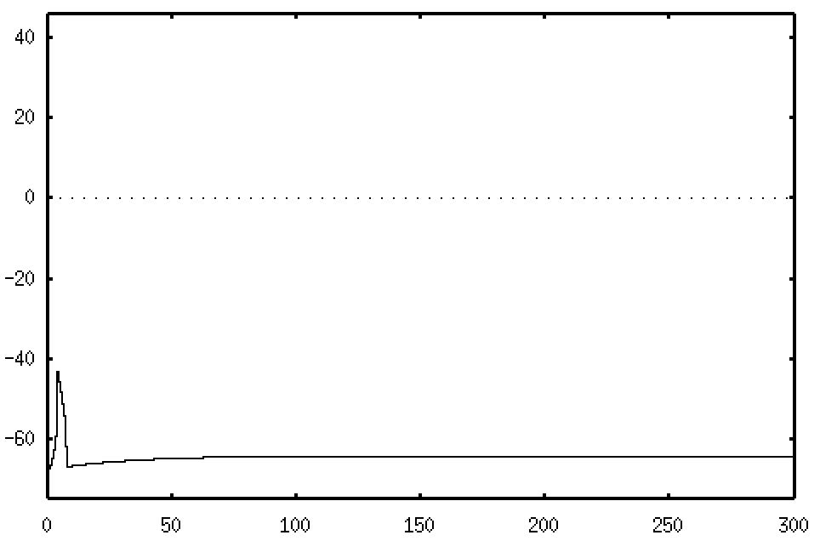
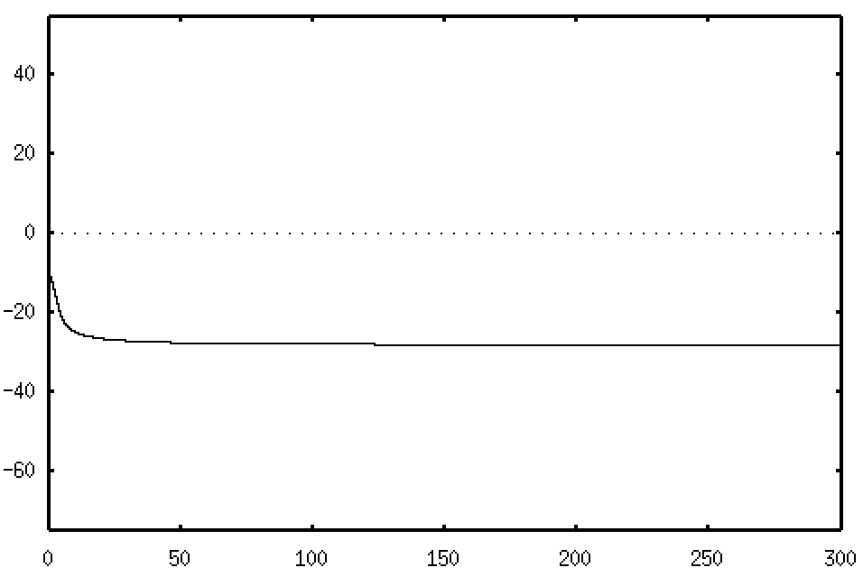
Bifurcation analysis of Lansdell et al. Model
Calcium conductance

Slide 51
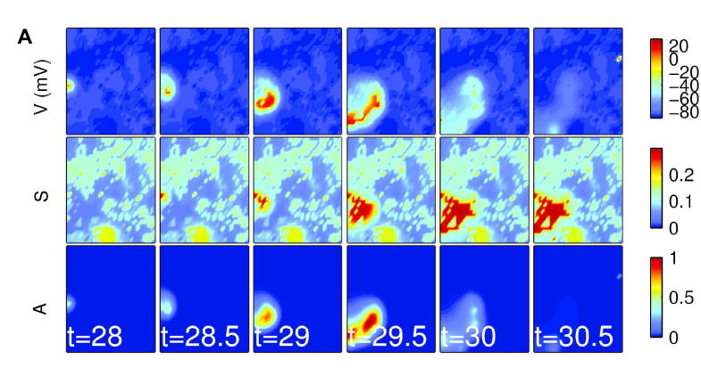
Bifurcation analysis of Lansdell et al. Model
Calcium conductance
Spatiotemporal front
(Lansdell et al.)

Slide 52
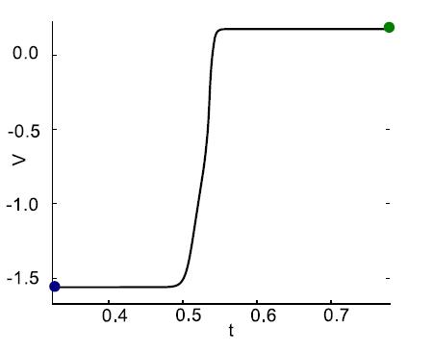
Conclusions on Lansdell et al. model
Varying the amplitude of the external excitatory current In we have a transition from a low voltage state to a high one.
In the paper they obtain fronts as a result of heteroclinic orbits connecting low and high states of activity
Heteroclinic orbit- Voltage profile of the wave front, Lansdell et al.

Slide 53
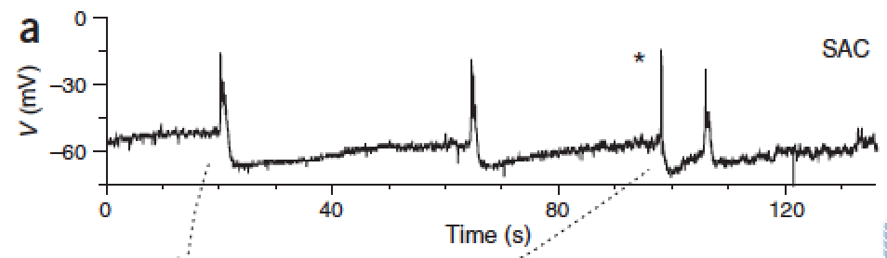
Conclusions on Lansdell et al. model
Also there is no bursting activity for SACs as it is found in Zheng 2006.
Zheng 2006, Busting activity SACs

Slide 54
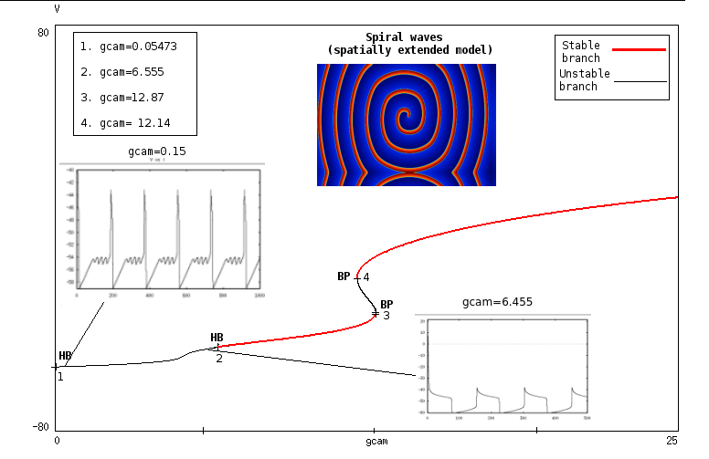
Bifurcation analysis of Lansdell et al. Model with a tuned set of parameters
Now if we change the value of the binding constant for acetylcholine to what was found in the literature we obtain the following:

Slide 55
Bifurcation analysis of Lansdell et al. Model with a tuned set of parameters
The reward of using bifurcation analysis tools: when we couple neurons by diffusion, local spiking activity generically produces spiral waves in 2D (theorem by Schell et al.)

Slide 56
Comments
Lansdell et al. model produces spiral waves after a biophysical tuning of parameters
Spirals seem too perfect and not biophysically related
Why?
sAHP is not realistically modeled
Symmetries in Lansdell model
Refractory mechanism due to sAHP should disrupt the waves

Slide 57
Ongoing and Future Work
We expect to have more realistic spatio-temporal patterns with respect to the experiments if we consider spiral waves due to more realistic sAHP modelling
Spatio-Temporal evolution of a retinal wave in mice during development, Maccione et al. 2014

Slide 58
Ongoing and Future Work
Vary parameters which are related to conductances of the ionic channels of the full model
Which type of local dynamics can we observe varying parameters?
Which type of dynamics (fronts, spirals,etc) can we produce by varying pharmacological terms?
Investigate a higher order effect (non linear) for the acetylcholine diffusion.
Do we predict some regimes of behaviour not observed before?

Slide 59
Aknowledgements
Matthias Hennig, University of Edinburgh
Evelyne Sernagor, Newcastle University
Olivier Marre, Vision Institute, Paris
Serge Picaud, Vision Institute, Paris

Slide 60
Thank you for your attention! ☺

Slide 61
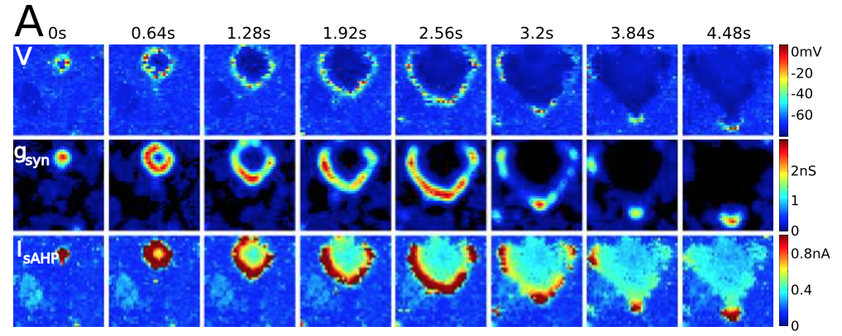
Existing Models for Stage II Retinal Waves
1.Hennig et. al (2009)
2. Lansdell et. al (2014)
Evolution of the membrane potential v,
synaptic conductance gsyn, Isahp
Evolution of the membrane potential V,
gating variable for sahp current S,
acetylcholine concentration A

