Slide 1
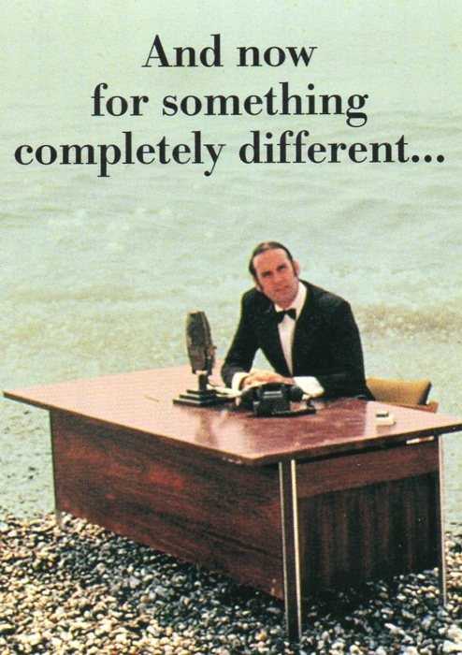
The Renner Effect:
An Example of the Break- down of the Born-Oppenheimer Approximation
Per Jensen
Professor, Ph.D.
School of Mathematics and Natural Sciences
Physical and Theoretical Chemistry
University of Wuppertal
D-42097 Wuppertal
Germany
Tel. +49 (0) 202 - 439 2468
jensen@uni-wuppertal.de
(Picture courtesy of
M. Python)

Slide 2
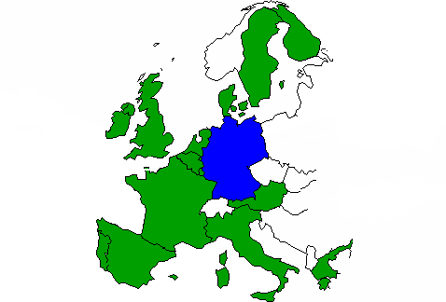
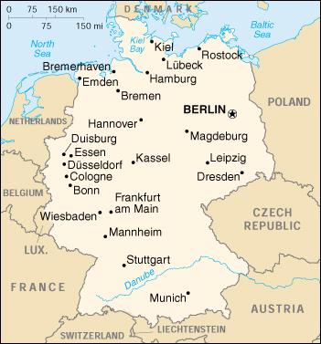
Where is
Wuppertal?

Slide 3
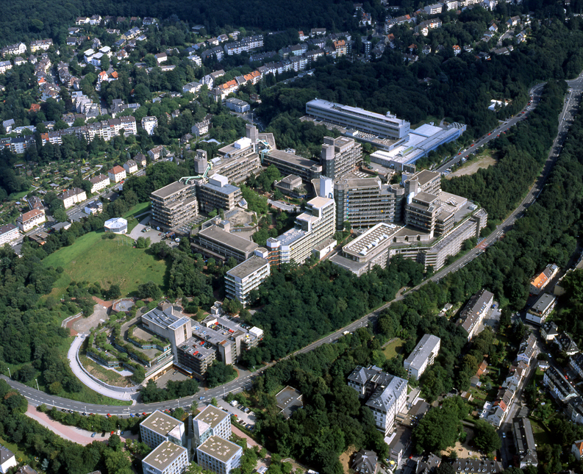


Bergische Universität Wuppertal

Slide 4
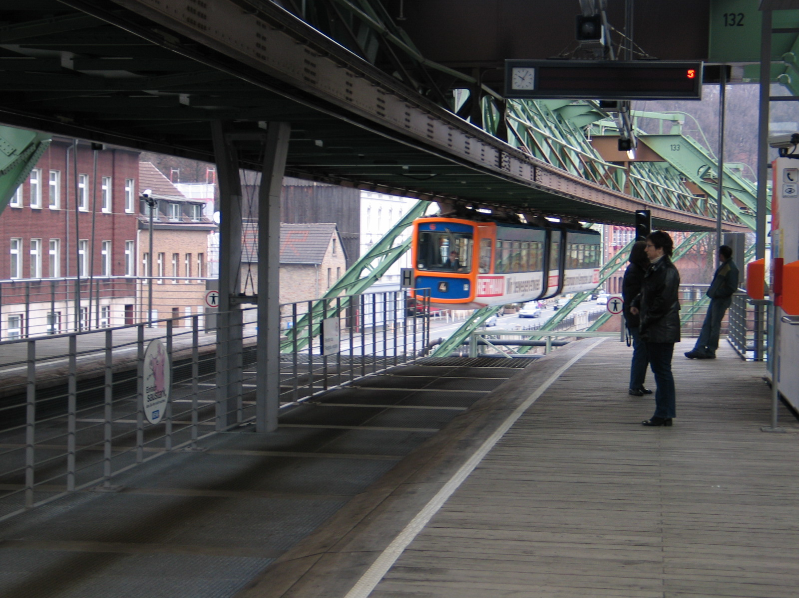
The Schwebebahn (monorail) in Wuppertal

Slide 6
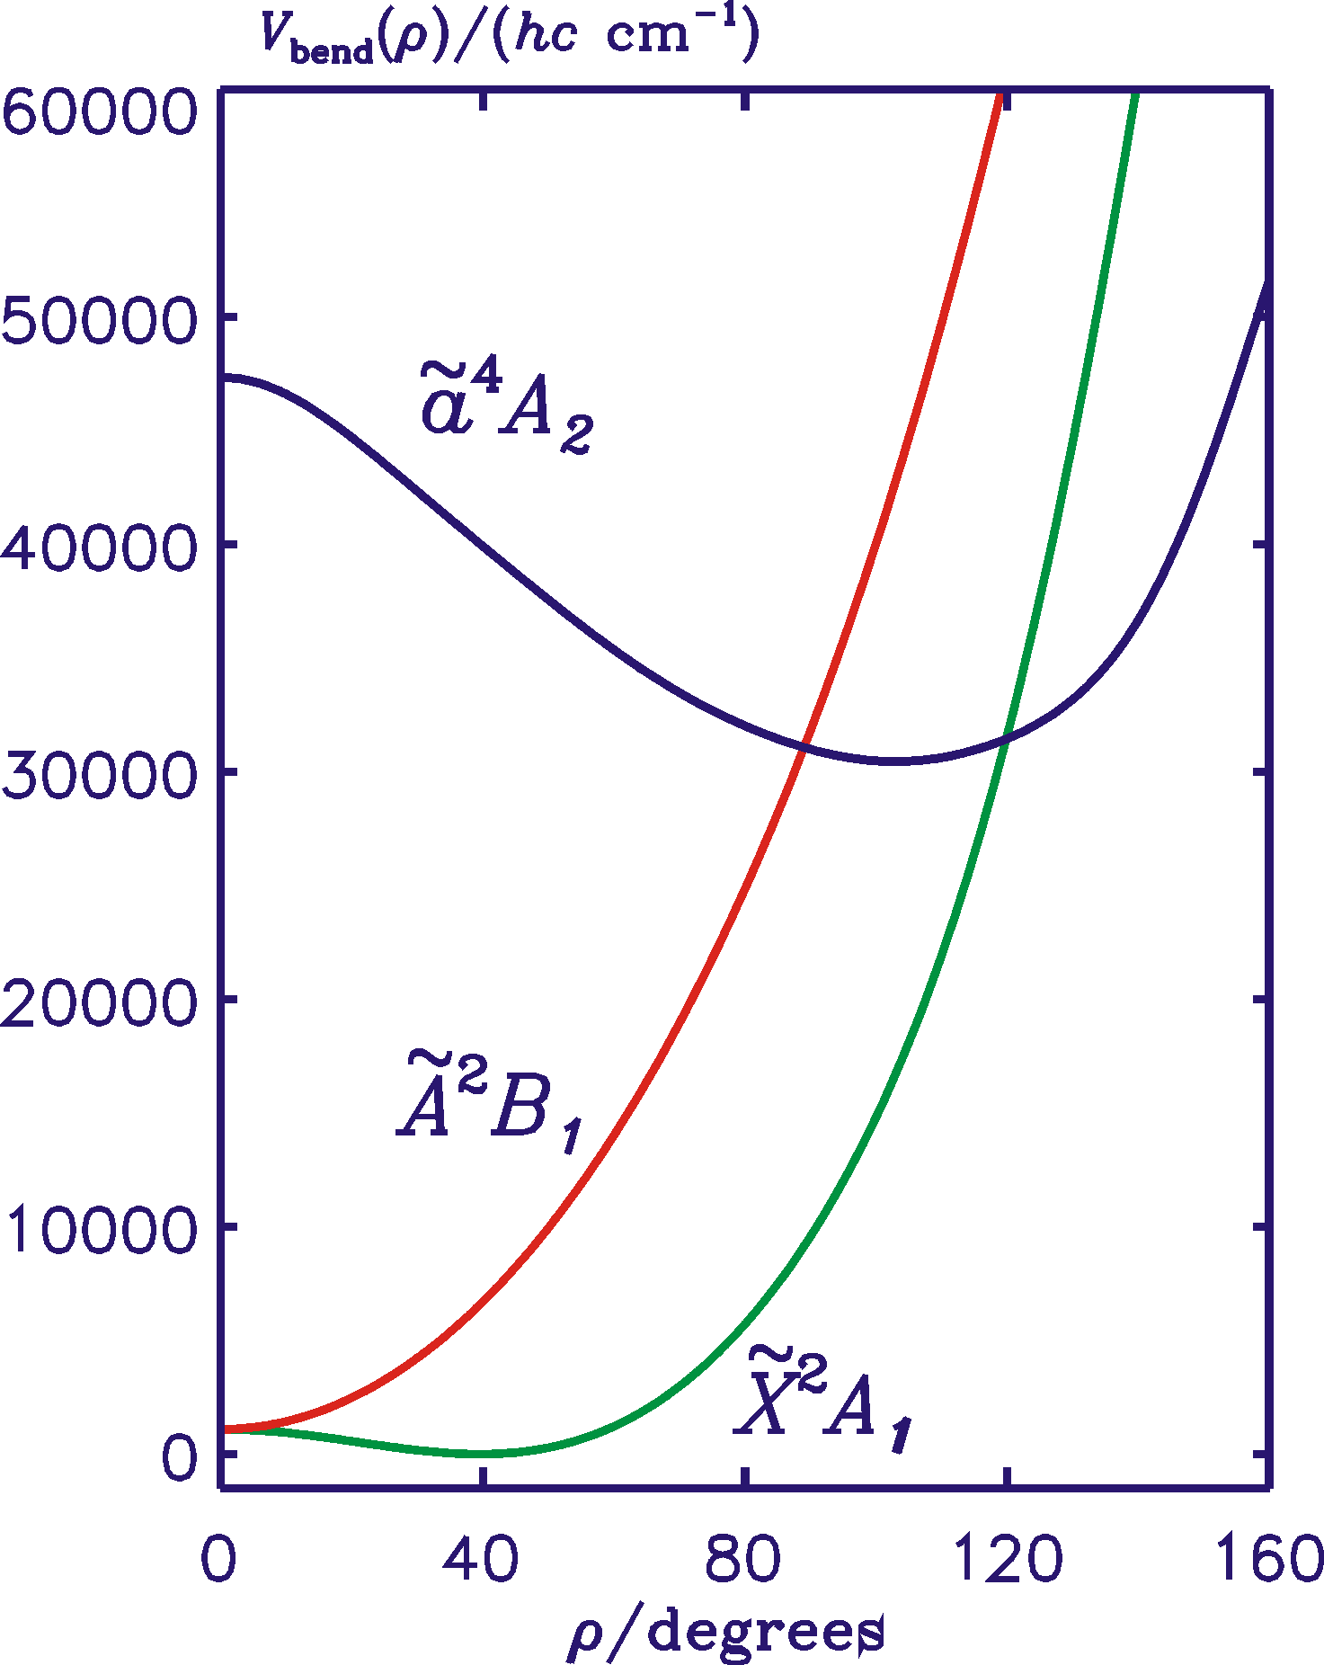
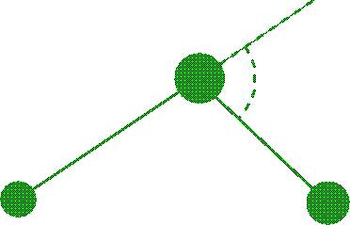
+
CH₂ RENNER EFFECT
ρ
Λ
(0
Σ)
1 Π
2 Δ
3 Φ
...
P
2

Slide 7
Computer programs:
RENNER:
Triatomic molecule in Renner-degenerate states. Only one linear geometry considered.
DR (Double Renner):
Triatomic molecule in Renner-degenerate states. Two linear geometries considered.
P. Jensen, M. Brumm, W. P. Kraemer, and P. R. Bunker, J. Mol. Spectrosc. 171, 31-57 (1995). DOI: 10.1006/jmsp.1995.1101
M. Kolbuszewski, P. R. Bunker, W. P. Kraemer, G. Osmann, and P. Jensen, Mol. Phys. 88, 105-124 (1996). DOI: 10.1080/00268979650026622
G. Osmann, P. R. Bunker, P. Jensen, and W. P. Kraemer, Chem. Phys. 225, 33-54 (1997). DOI:10.1016/S0301-0104(97)00173-0
T. E. Odaka, P. Jensen, and T. Hirano, J. Mol. Structure 795, 14-41 (2006). DOI: 10.1016/j.molstruc.2005.10.059
V. V. Melnikov, T. E. Odaka, P. Jensen, and T. Hirano, J. Chem. Phys. 128, 114316/1-10 (2008). DOI: 10.1063/1.2827490

Slide 8
Variational calculation:
Construct matrix representation of the total Hamiltonian in terms of suitable basis functions
Morse-oscillator (or Morse-oscillator–like) functions for stretching motion.
Numerical bending functions generated by Numerov-Cooley integration
Coupled (rigid rotor)-(electron spin) basis functions for the rotation
( )
Diagonalize matrix numerically – however the matrix blocks will become very large ..... What should we do?

Slide 9
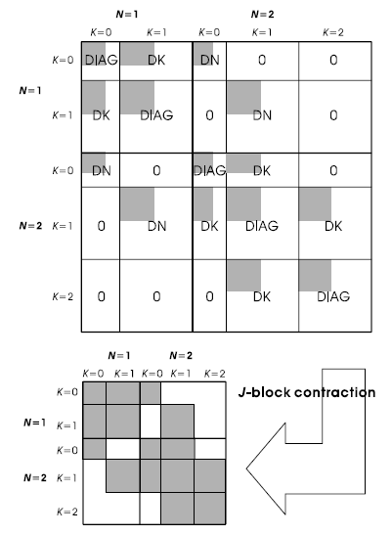
Contract!
Ignore end-over-end rotation and calculate the eigenenergies and wavefunctions for a hypothetical molecule that rotates about the a axis only.
Use (a smaller number of) the resulting eigenfunctions as basis functions for the final problem, including end-over-end rotation.
Principle of the contraction in DR

Slide 10
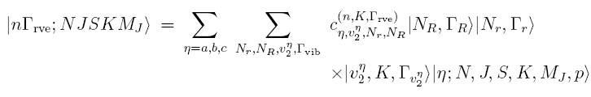
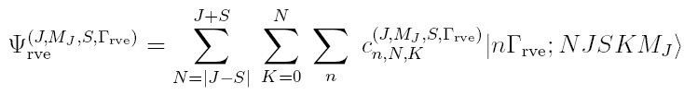
Total rovibronic wavefunction:
Contracted basis function
Stretch
Stretch
Bend
Two electronic states
Elec + Rot + e-spin

Slide 11



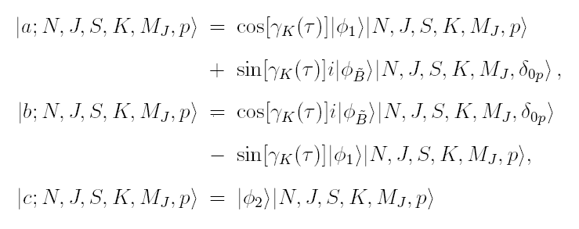
Electronic, rotational, e-spin:
+
CH₂
~
X ²A₁
results from prediagonalization
of Renner interaction at given
value of the bending angle
~
A ²B₁

Slide 12
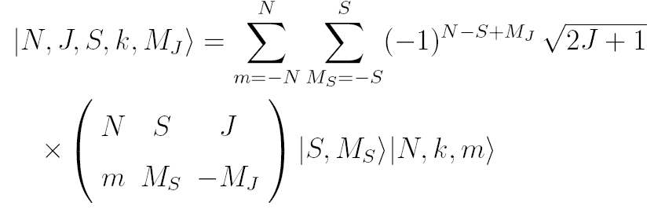
Rotation, e-spin:
Symmetrized, „parity basis“
Unsymmetrized, coupled rotation/e-spin

Slide 13
+
+
Application of RENNER: CH₂
ρ
Λ
(0
Σ)
1 Π
2 Δ
3 Φ
...
P
2

Slide 14
CH₂ Calculations
+
Ab initio potential energy functions from W. P. Kraemer, Per Jensen, and P. R. Bunker, Can. J. Phys. 72, 871-878 (1994)
One parameter of the potential energy function has been adjusted to obtain agreement with experiment for the ν₃ vibrational term value in the X ²A₁ state.
~
~
CH₂ Experiment
+
~
X ²A₁ ν₃ band (K_{a} = 0 ← 0 and 1 ← 1) measured by M. Rösslein, C. M. Gabrys, M.-F. Jagod, and T. Oka, J. Mol. Spectrosc. 153, 738-740 (1992).
Photoelectron spectrum of CH₂; S. Willitsch and F. Merkt: J. Chem. Phys. 118, 2235-2241 (2003).
A ²B₁ ← X ²A₁ electronic spectrum; J. L. Gottfried and T. Oka, J. Chem. Phys. 121, 11527 (2004)
~
~

Slide 15
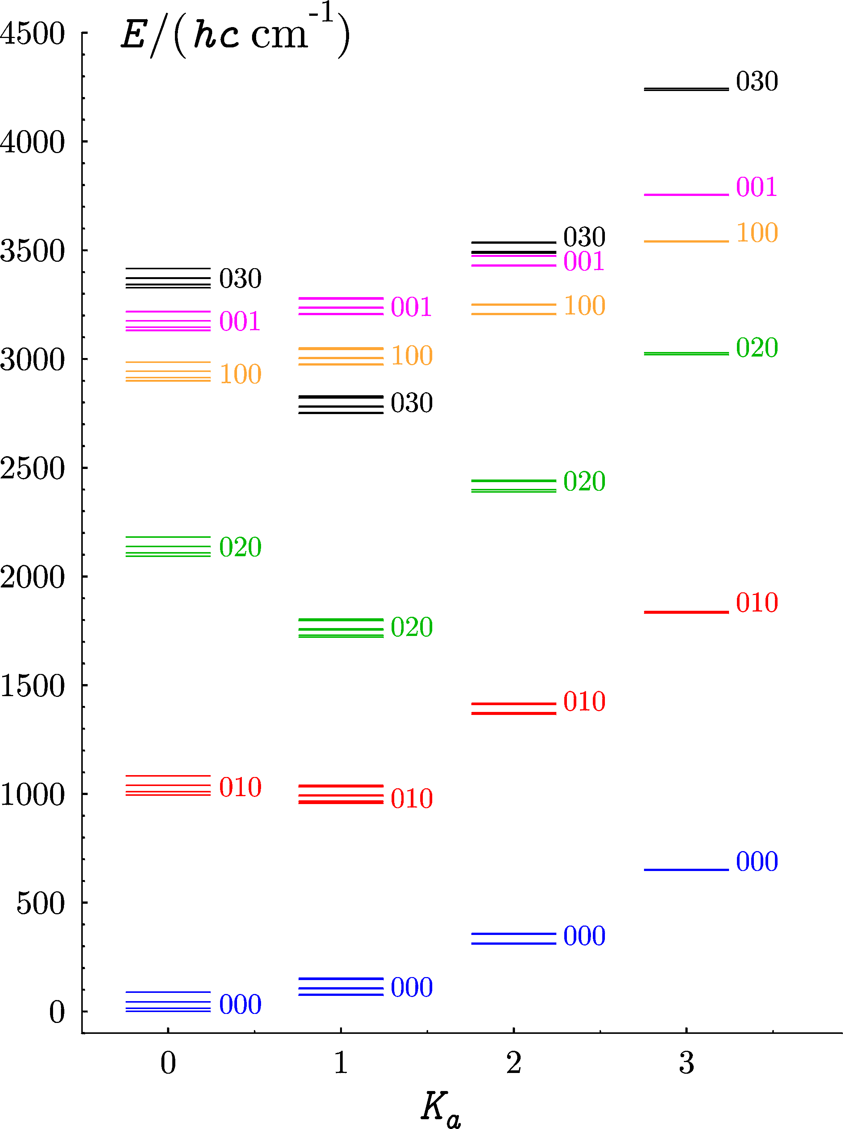
+
CH₂
~
S. Willitsch and F. Merkt: J. Chem. Phys.
118, 2235-2241 (2003):
„... calculated positions of K_{a}=0,1 levels are
in very good agreement, whereas the K_{a}=2 levels
are predicted systematically at about 5 cm⁻¹ lower
wave numbers....“
X ²A₁
N ≤ 3
J ≤ 7/2

Slide 16
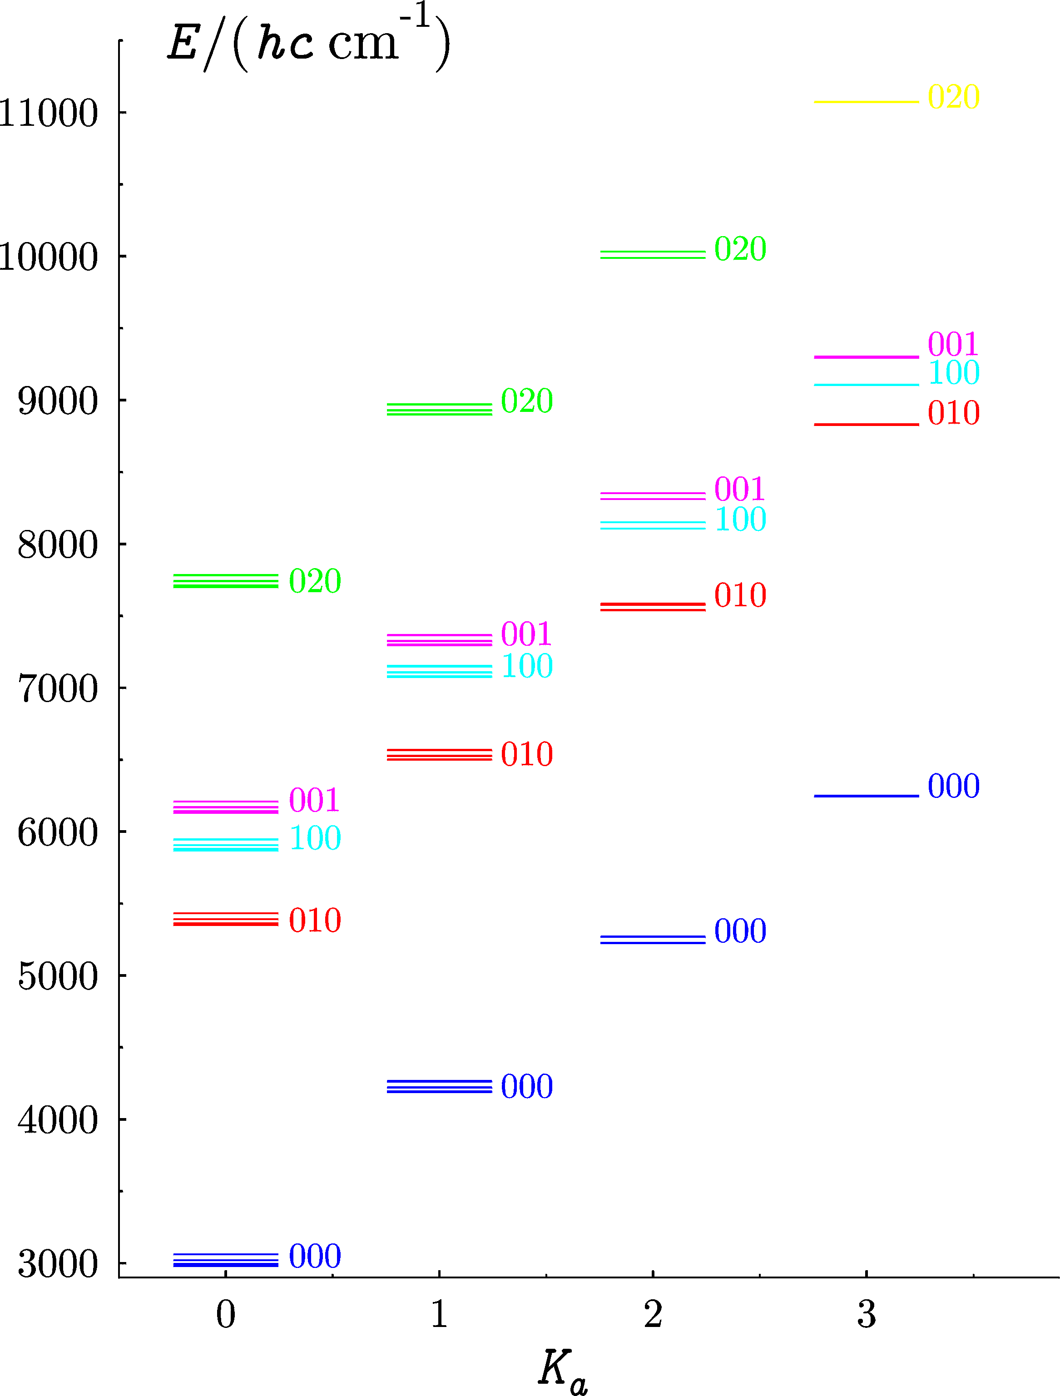
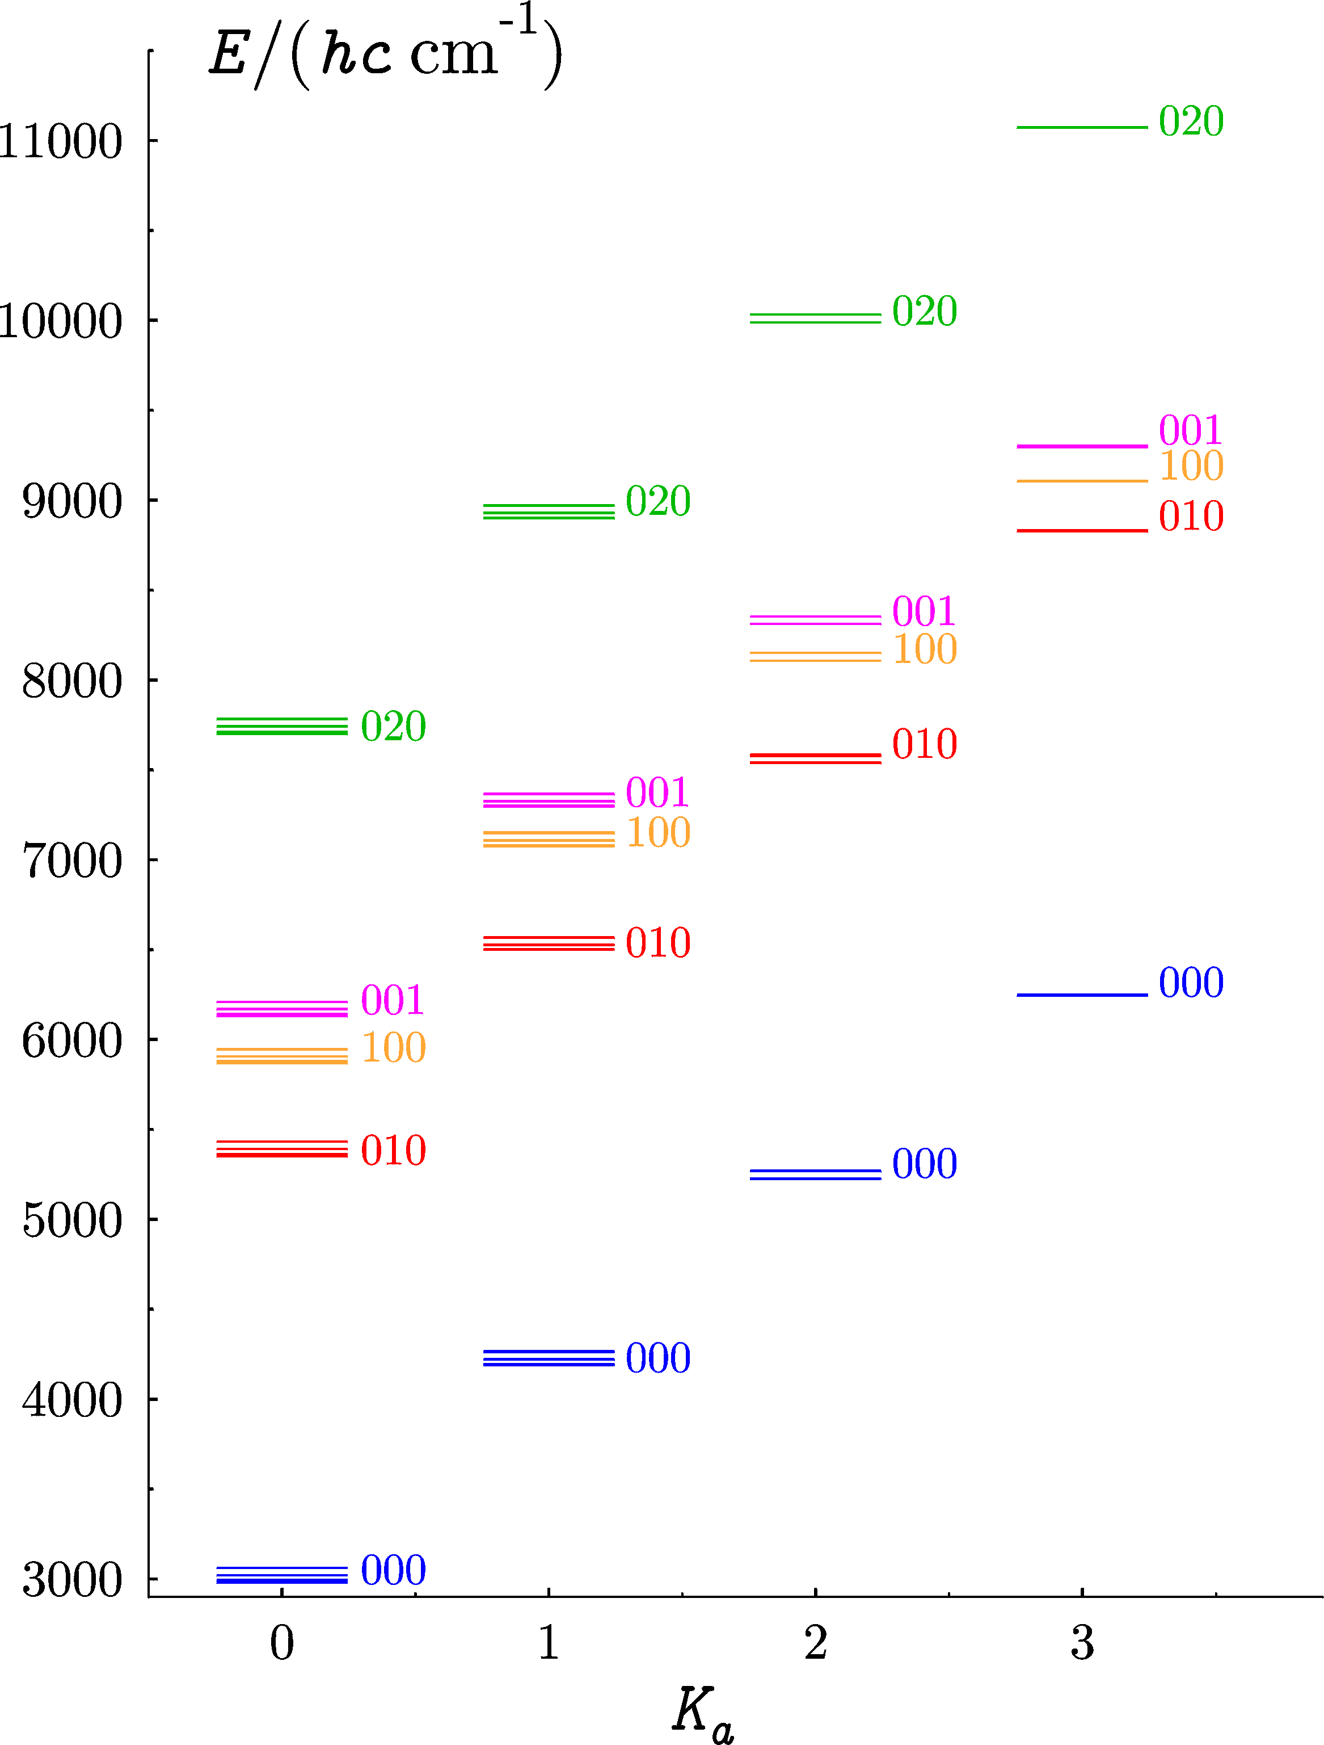
+
CH₂
~
A ²B₁
N ≤ 3
J ≤ 7/2

Slide 17
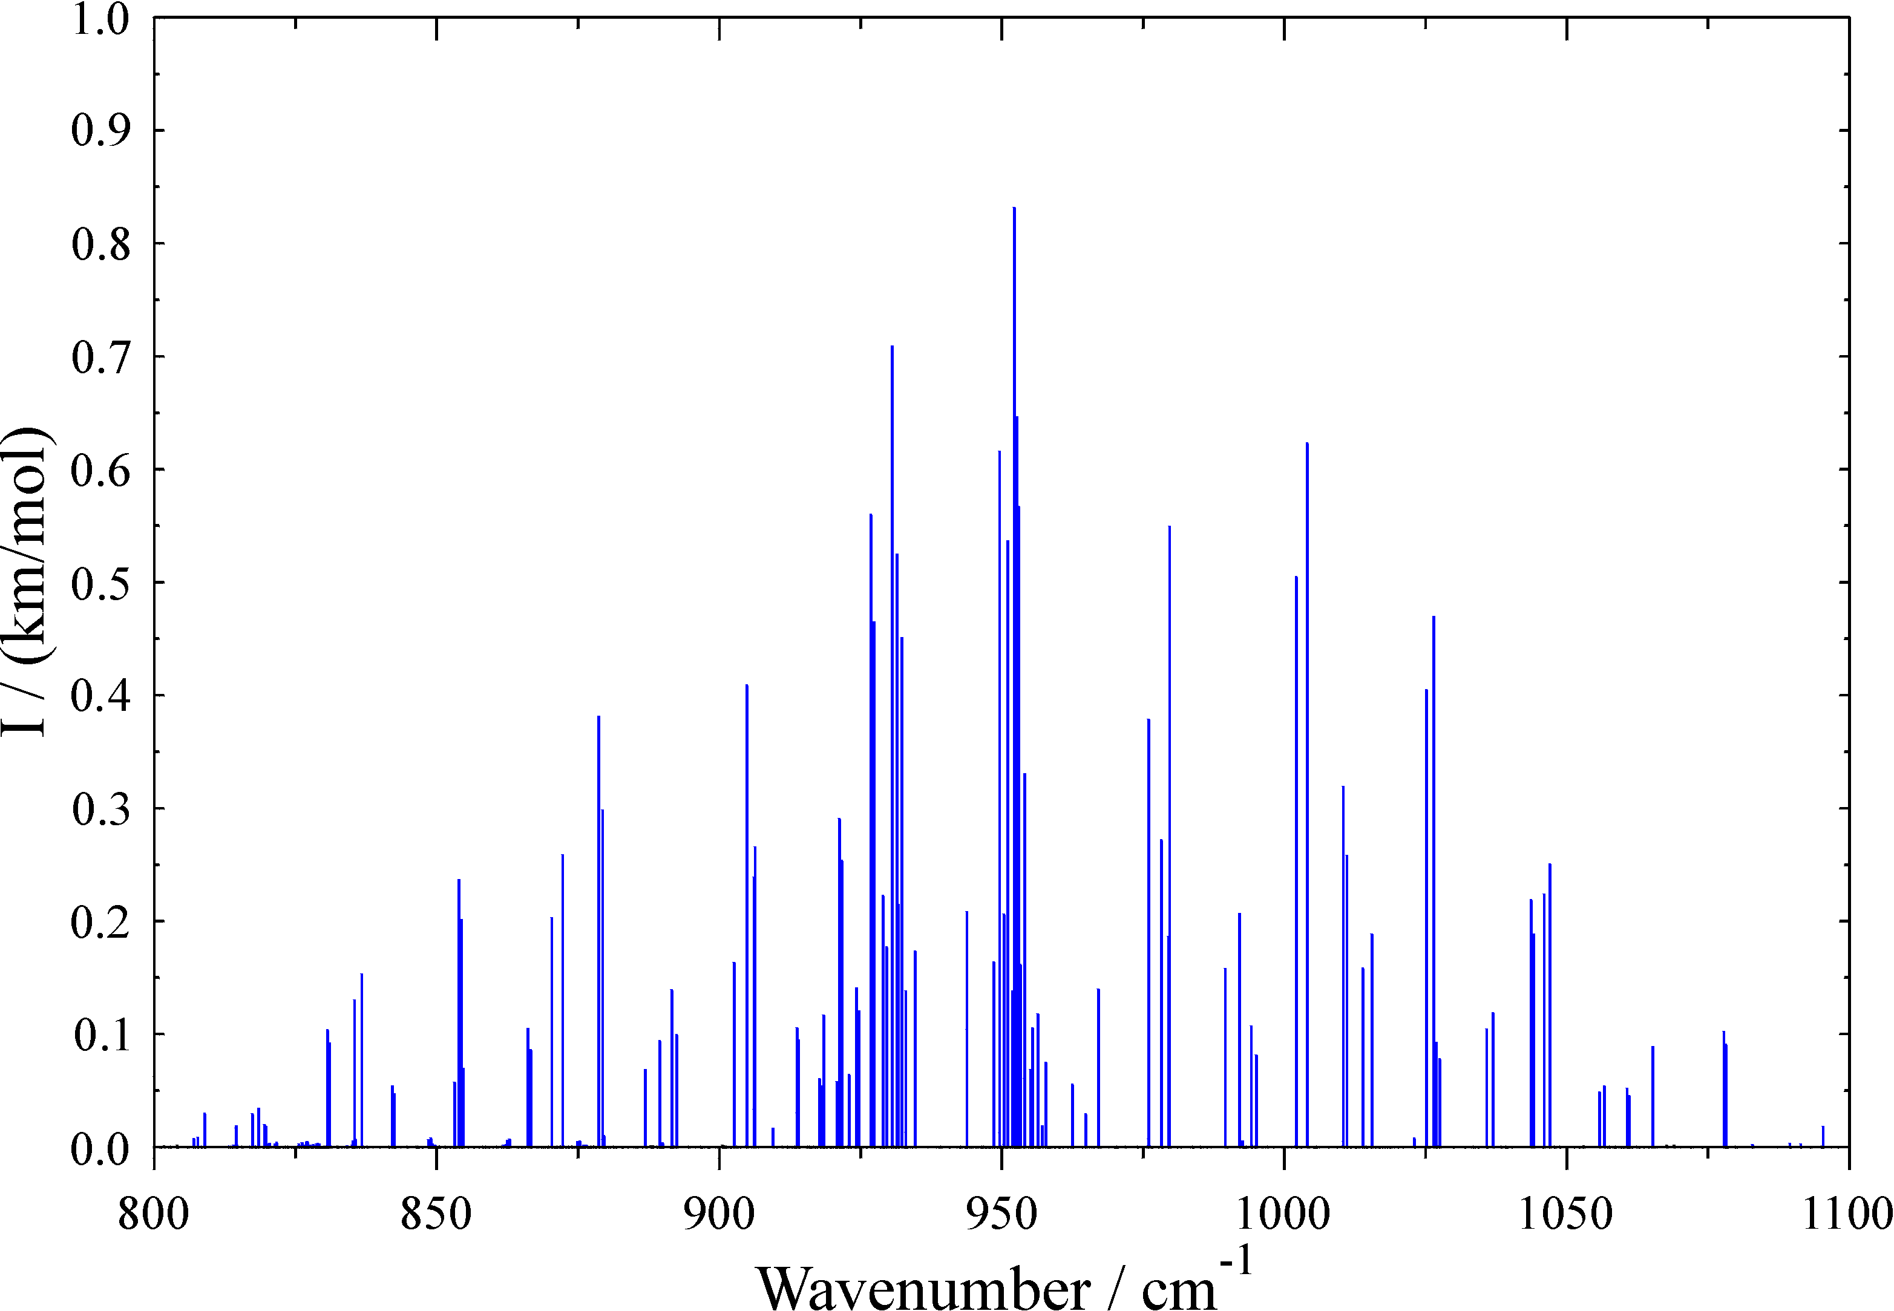
~
+
CH₂
X ²A₁
N ≤ 10 T = 300 K
n₂ band

Slide 18
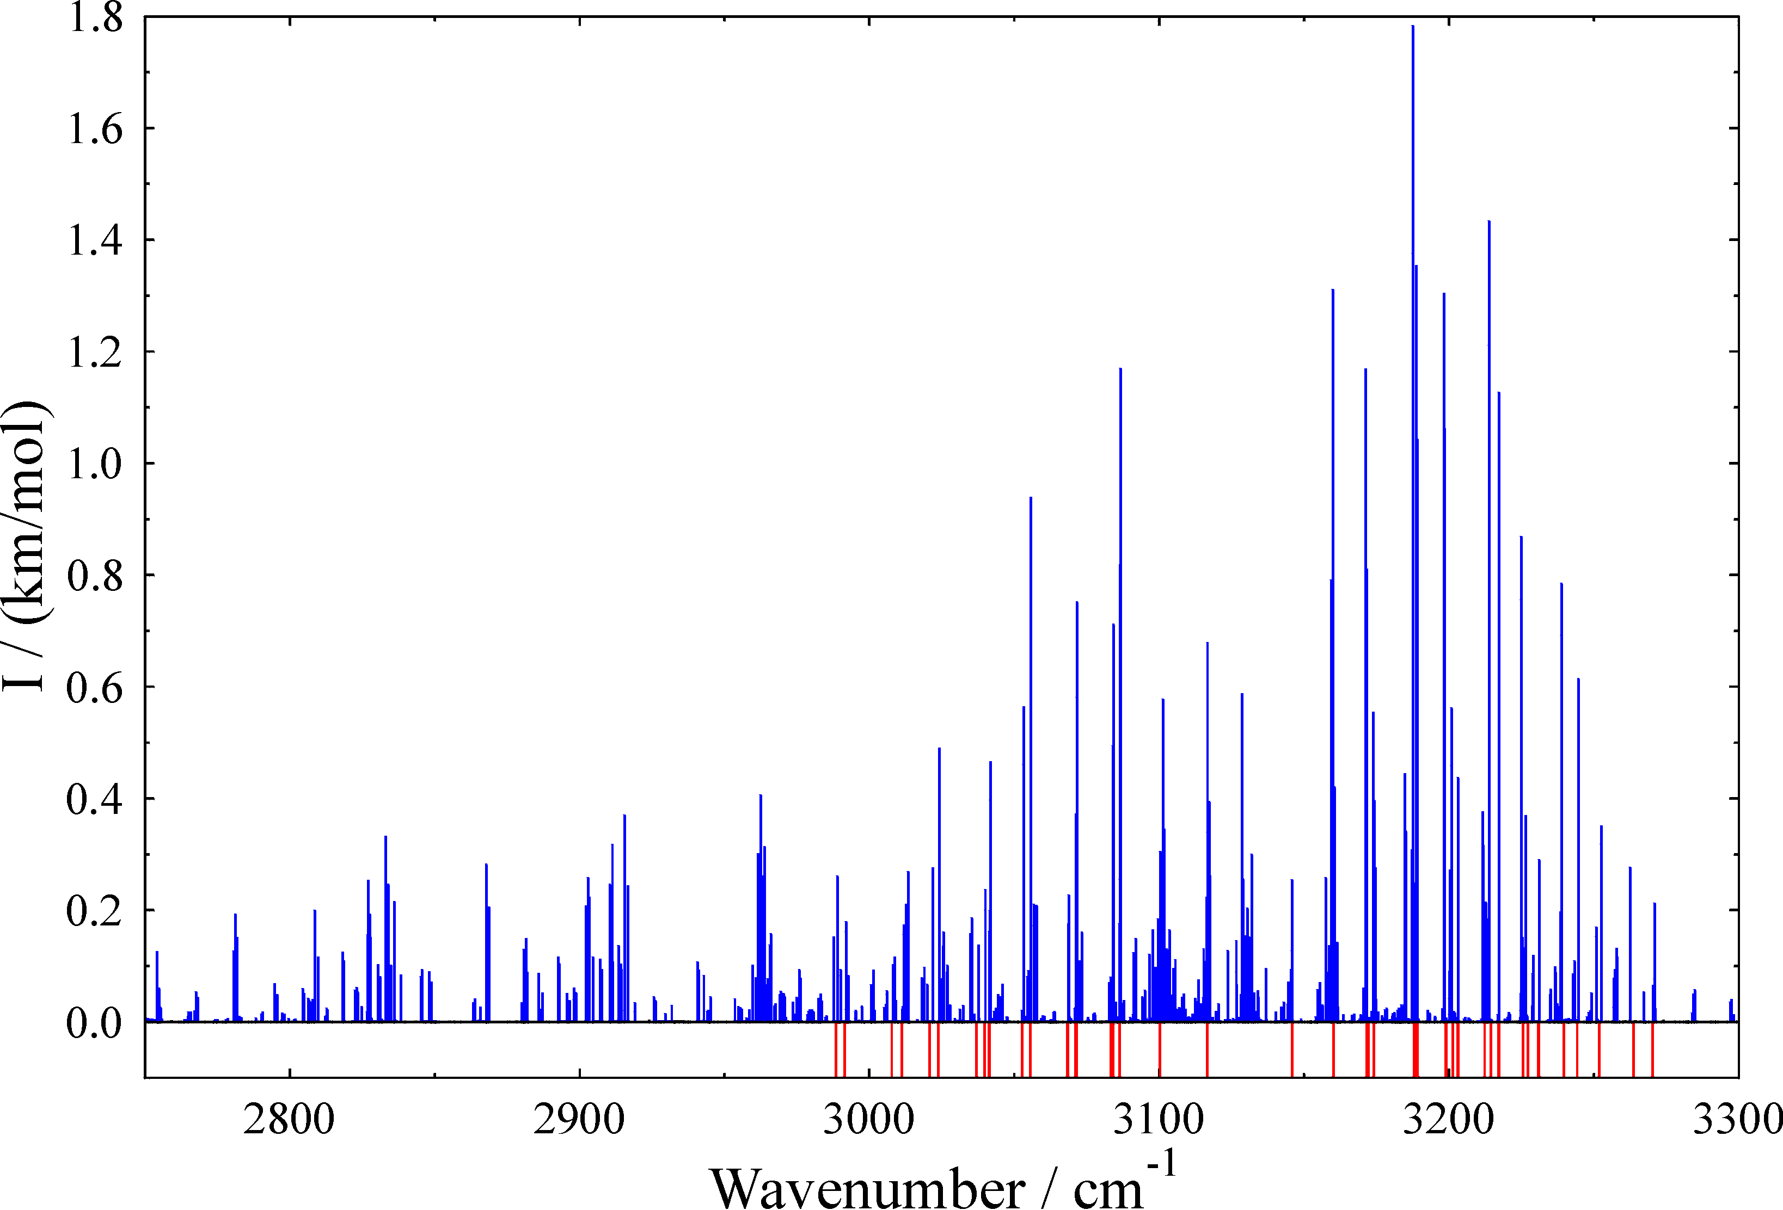
~
+
CH₂
X ²A₁
N ≤ 10 T = 300 K
n₂ band
n₁/n₃ bands
Lines observed by Oka

Slide 19
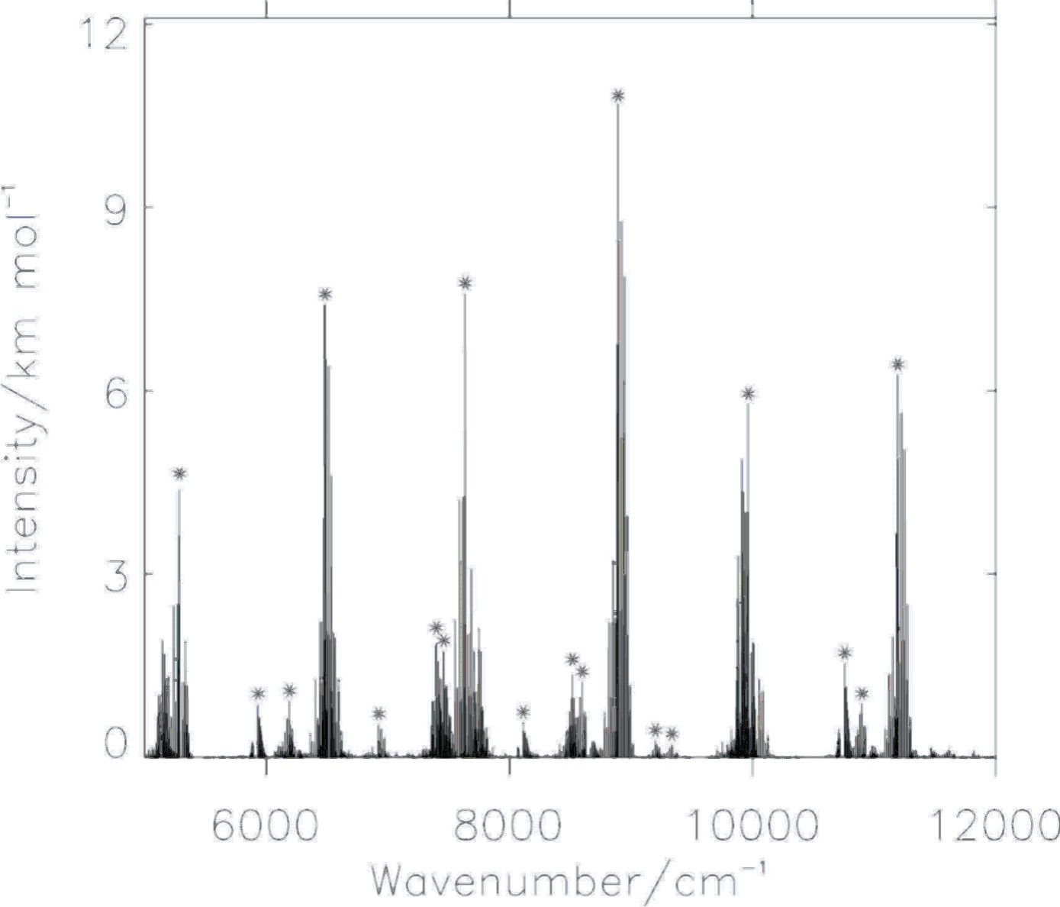
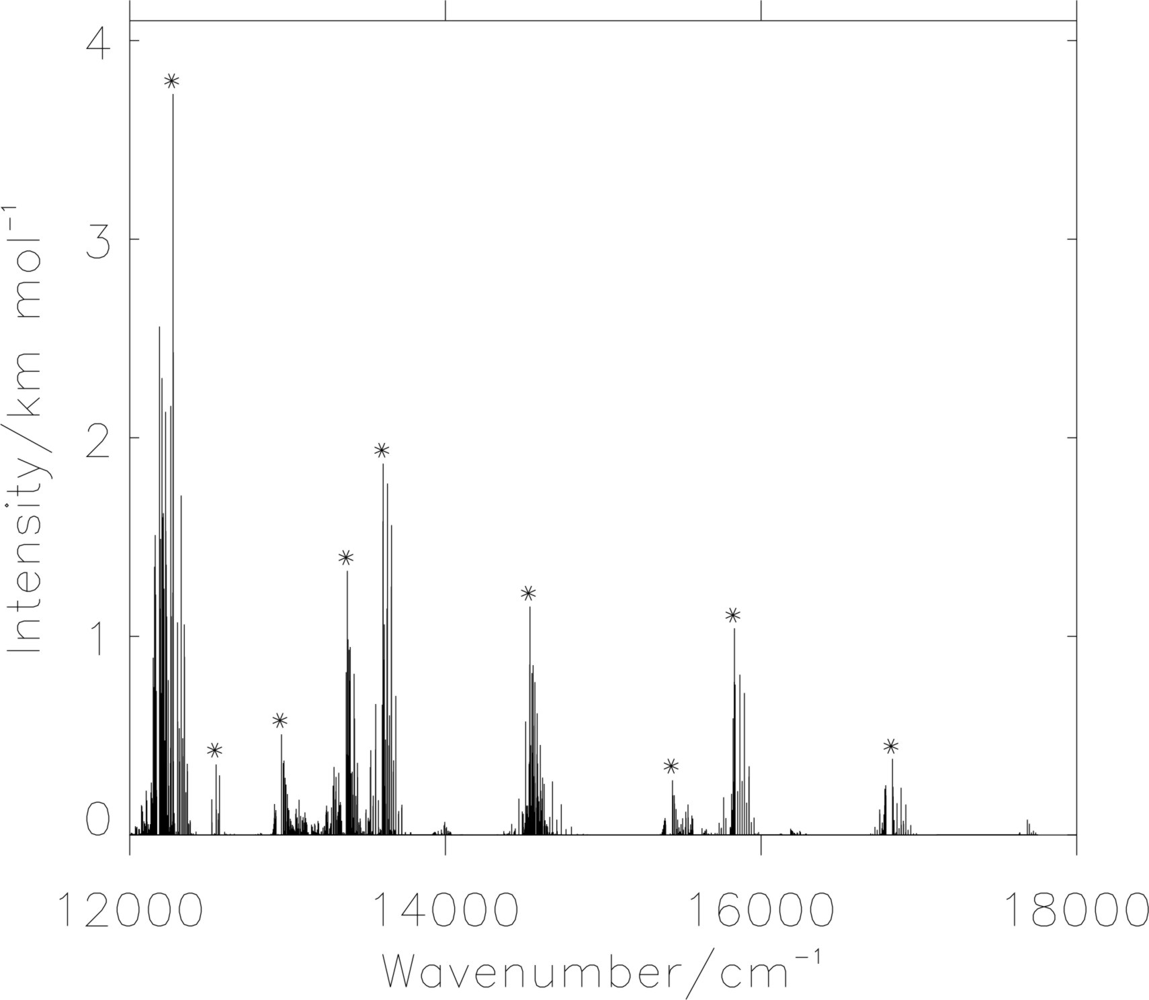
+
CH₂
~
~
A(0,3,0)¹←X(0,0,0)⁰
o-c = −53 cm⁻¹
~
~
A ²B₁
←
X ²A₁
~
~
A(0,4,0)⁰←X(0,0,0)¹
o-c = −18 cm⁻¹
J. L. Gottfried and T. Oka,
J. Chem. Phys. 121, 11527 (2004)

Slide 20
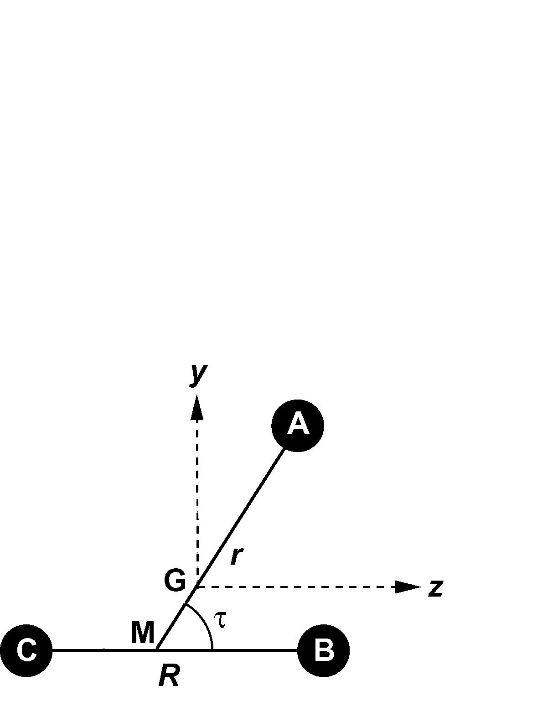
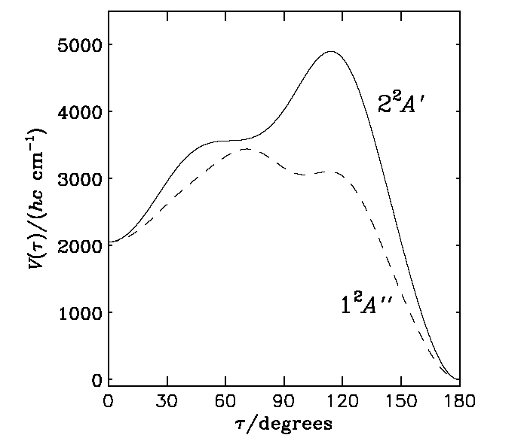
Application of DR: MgCN/MgNC
~
Ab initio calculation:
MR-SDCI(+Q)/[TZ3P+f (Mg), aug-cc-pVQZ (N and C)]
A ²Π
Mg
C
N
MgNC
MgCN

Slide 21
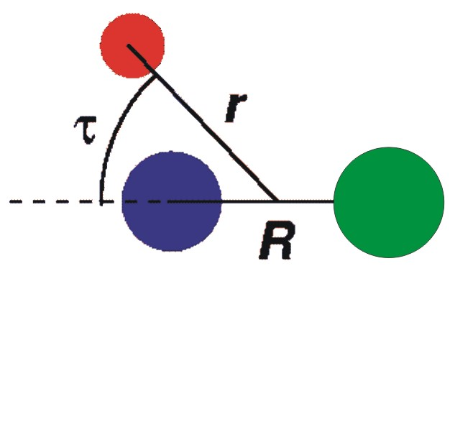
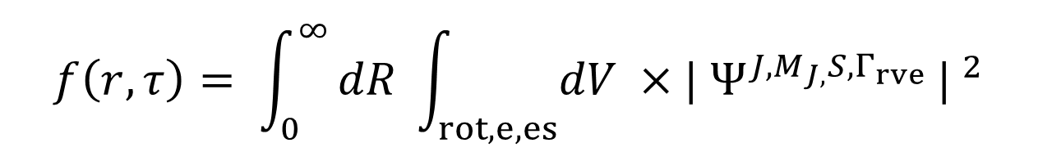
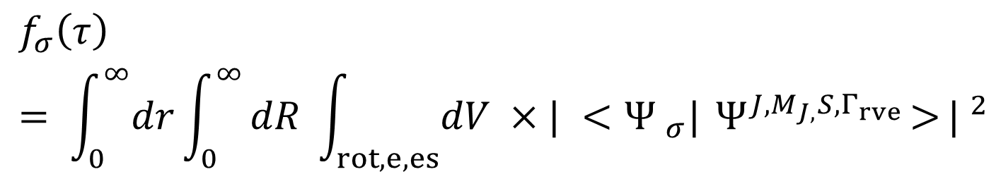
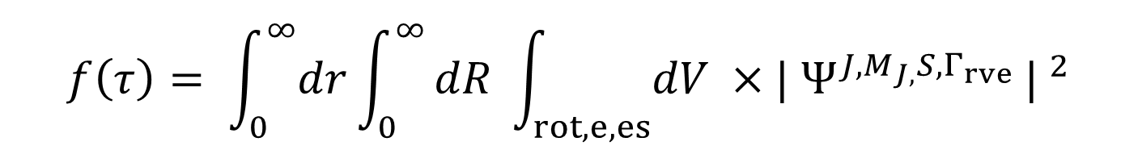
Probability density functions
$$f\left(r,τ\right)= \int_{0}^{∞}{dR \int_{rot,e,es}{dV ×| Ψ^{J,M_{J,}S,Γ_{rve}}}|} ^{2}$$
$$f\left(τ\right)= \int_{0}^{∞}{dr}\int_{0}^{∞}{dR \int_{rot,e,es}{dV ×| Ψ^{J,M_{J,}S,Γ_{rve}}}|} ^{2}$$
$$f_{σ}\left(τ\right)= \int_{0}^{∞}{dr}\int_{0}^{∞}{dR \int_{rot,e,es}{dV ×| <{Ψ }_{σ}|{ Ψ}^{J,M_{J,}S,Γ_{rve}}>}|} ^{2}$$
σ = − for the lower (1 ²A´´ for MgNC/MgCN) state
σ = + for the upper (2 ²A´ for MgNC/MgCN) state

Slide 22
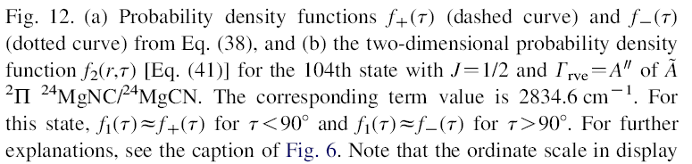
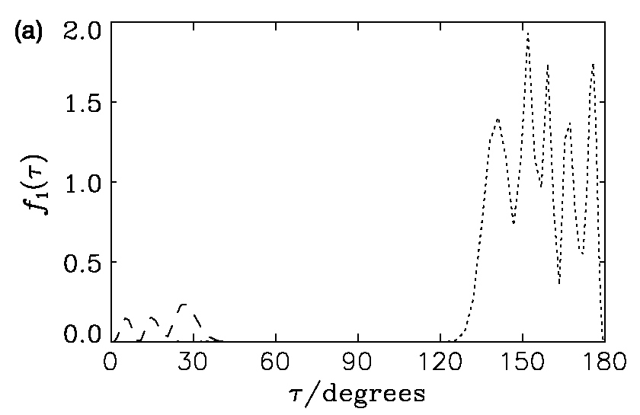
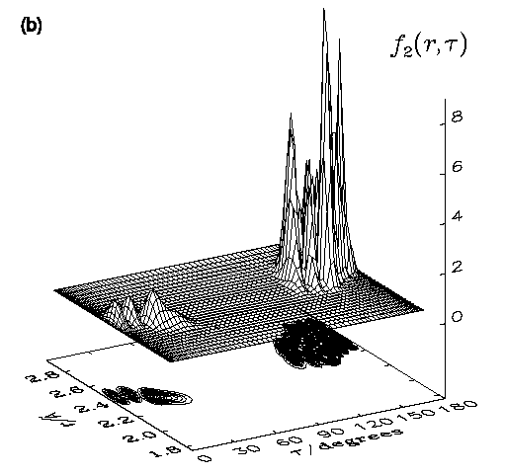
MgCN
MgNC
Renner-driven
isomerization

Slide 23
Application of DR: HOO/OOH
~
~
ab initio calculations:
X ²A´´ and A ²A´ states
Program: MOLPRO 2002.6
Method: Core-valence MR-SDCI+Q/[aug-cc-pCVQZ (O), cc-pVQZ (H)]
Basis set for hydrogen: Dunning et al.’s correlation consistent valence quadruple zeta basis set (cc-pVQZ),(6s,3p,2d,1f)/ [4s,3p,2d,1f]
Basis set for oxygen: Dunning et al.’s augmented correlation consistent polarized core-valence valence quadruple zeta basis set (aug-cc-pCVQZ),(16s,10p,6d,4f,2g)/[9s,8p,6d,4f,2g]

Slide 24
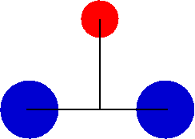

HOO minimum energy paths
V/cm⁻¹
~
A ²A´
~
X ²A´´
11805.1 cm⁻¹
13555.9 cm⁻¹
20656.5 cm⁻¹
7100.6 cm⁻¹
13450.4 cm⁻¹
τ/degrees

Slide 25
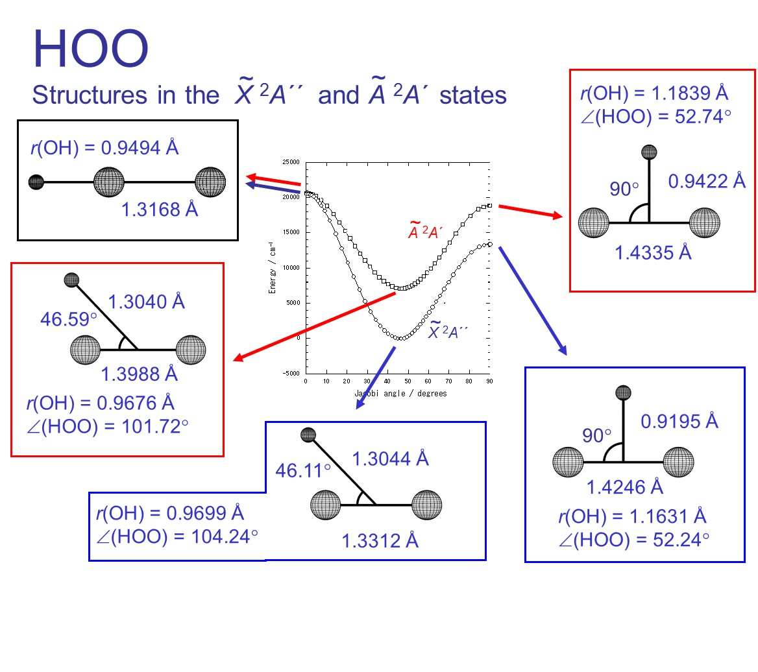

Slide 26
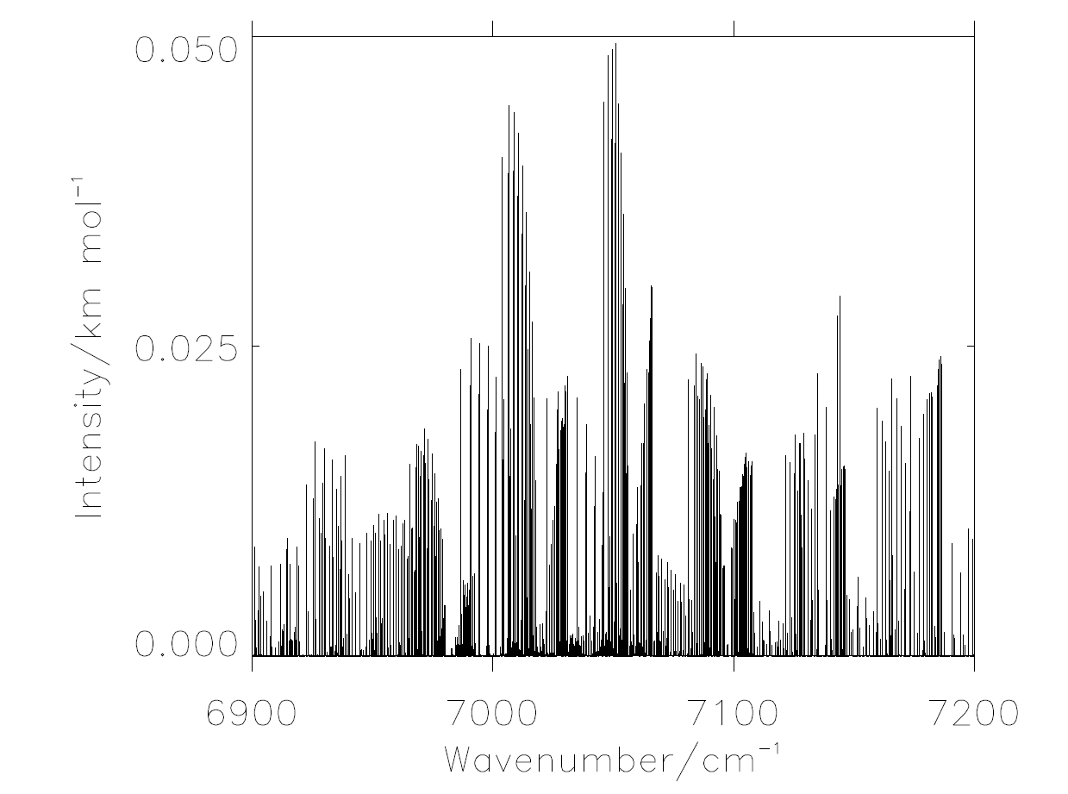
~
~
Simulation of HOO A ²A´ ← X ²A´´ absorption spectrum
T = 300K
N ≤ 10
J ≤ 19/2

Slide 27
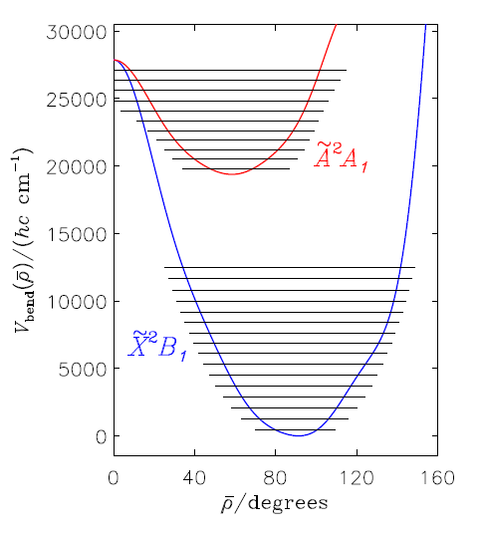
Application of RENNER: SbH₂
ab initio calculations:
all-electron complete active space self-consistent field (CASSCF) method, followed by a multireference
configuration interaction (MRCI) treatment
Hydrogen: aug-cc-pV5Z basis set
Antimony: Sapporo-DKH3-QZP-2012 basis set
non-relativistic and Douglas-Kroll-Hess (DKH) Hamiltonians
A_{SO} = 2528 cm⁻¹
ρ
(using Breit-Pauli operator)

Slide 28
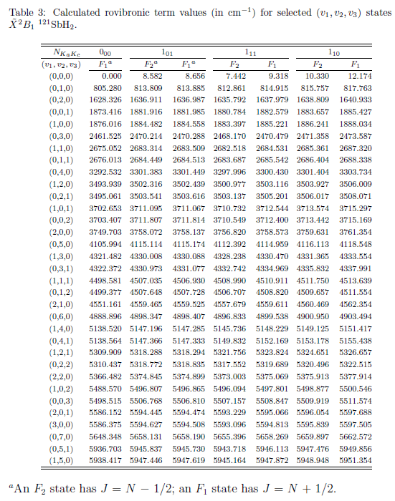
Rovibronic
Level
Clustering
At high J
Local Mode
behaviour

Slide 29
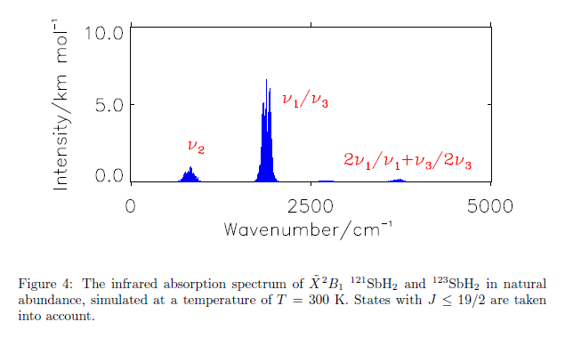
Simulation of SbH₂ absorption spectrum, 0 to 5000 cm⁻¹
extremely
weak
rotational
spectrum

Slide 30
Experimental work:
Matrix isolation infrared spectrum obtained by
reacting laser ablated Sb with hydrogen.
Wang, Souter and Andrews, JPCA, 107, 4244 (2003)
2. The visible absorption spectrum obtained by
flash photolysis of stibine (SbH₃).
Basco and Lee, Spectrosc. Lett. 1, 13 (1968)
3. The visible emission spectrum obtained by
UV laser photolysis of stibine.
Ni, Yu, Ma and Kong, CPL 128, 270 (1986)

Slide 31
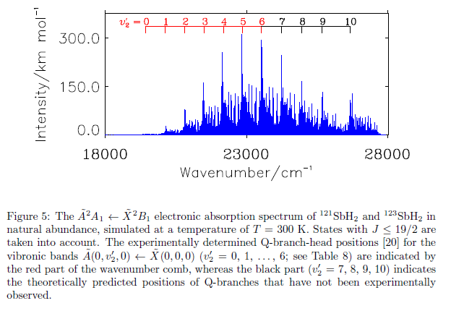
Visible absorption spectrum of SbH₃
Measured
Q-branch
heads
Simulated
Spectrum
(RENNER)
Flash photolysis

Slide 32
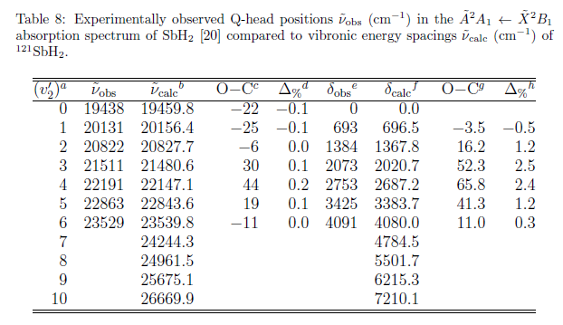
BUT
T_{e} (CAS-SCF MRCI) = 19255 cm⁻¹
It’s what you call
“fortuitous”
T_{e} (CCSD(T)) = 19478 cm⁻¹

Slide 33
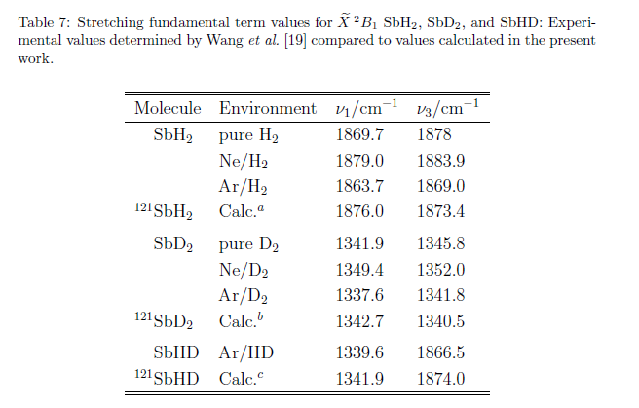
IR spectrum of
Laser ablated Sb + H₂ → matrix isolation
Experiment has ν₃ > ν₁ from NH₂

Slide 34
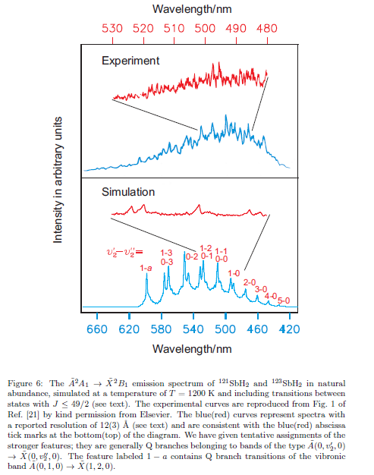
Emission spectrum. ArF laser photolysis of SbH₃
0-3
5-0
3 Å
12 Å
010-120
J(max) = 49/2
Simulation temperature = 1200 K for predominantly A-state levels.

Slide 35

Rovibronic energy level clustering at very high J-values
in the X ²B₁ state of SbH₂
~
J = ½ term values
Rovibronic symmetry
10.330
8.582
7.442
0.000
0.000
-1.748
-2.888
-10.330
A₂
A₁
B₂
B₁
plot

Slide 36
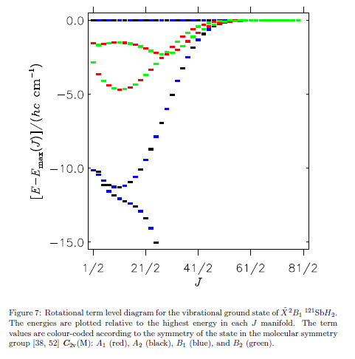
Rovibronic energy level clustering at very high J-values
Red A₁
Black A₂
Blue B₁
Green B₂

Slide 37
Thanks to numerous collaborators (in alphabetical order):
Martin Brumm
Philip R. Bunker
Tsuneo Hirano
Bruno Lang
Peter Langer
Vladlen V. Melnikov
Umpei Nagashima
Tina Erica Odaka
Gerald Osmann
Bojana Ostojić
Roman I. Ovsyannikov
Peter Schwerdtfeger
Walter Thiel
Sergei N. Yurchenko
Thanks for support from the European Commission,
the German Research Council (DFG), and the Foundation
of the German Chemical Industry (Fonds der Chemie).

